Slide 1
The world from “my” perspective

Slide 2
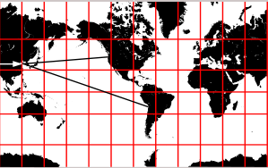

Slide 3
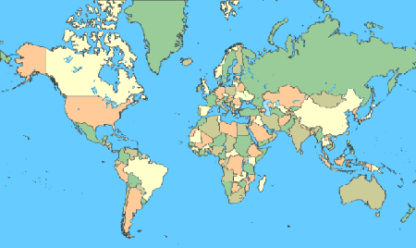

Slide 4
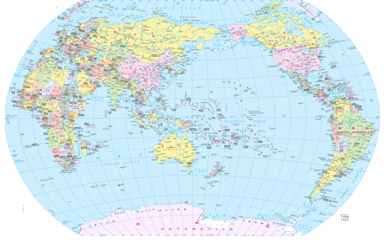

Slide 5
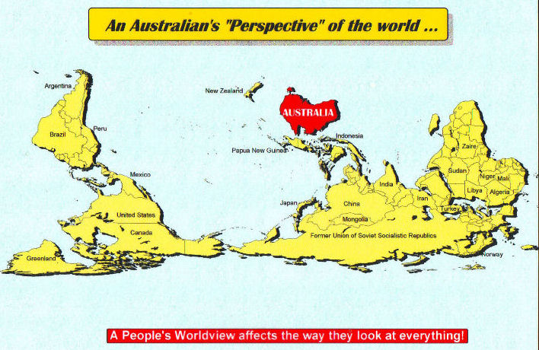

Slide 6
This PowerPoint presentation is available along with related materials and other PowerPoint presentations at http://home.snu.edu/~hculbert/ppt.htm

