Slide 1
Why I accept the Bible as authoritative
Howard Culbertson
Southern Nazarene University

Slide 2
1. Its internal claims to be the Word of God
Many Biblical writers say God laid His hand upon them and gave them something from Himself to declare.

Slide 3
2. Jesus and the Apostles quoted the Hebrew Bible (Old Testament) writings as authoritative

Slide 4
3. Through the ages the church has used the Bible as God’s inspired record of Himself and of His will

Slide 5
Sample doctrinal statement on inspiration of the Bible
“We believe in the plenary inspiration of the Holy Scriptures, by which we understand the 66 books of the Old and New Testaments, given by divine inspiration, inerrantly reveal the will of God concerning us in all things necessary to our salvation”

Slide 6
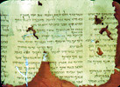
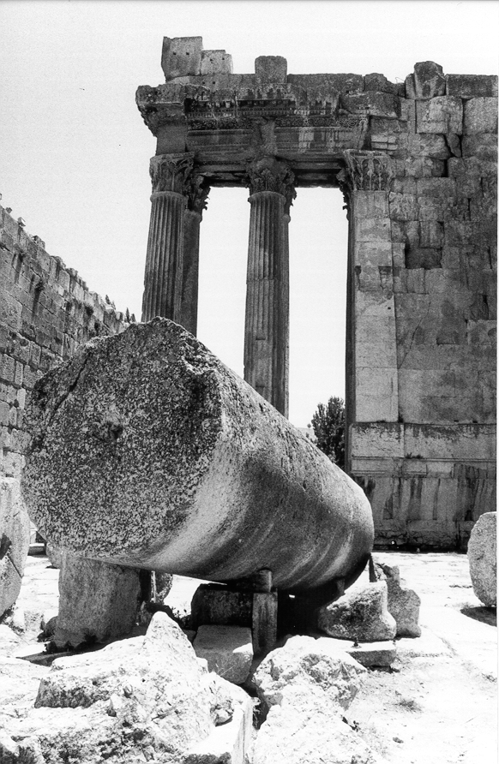
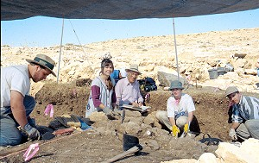
4. History and archaeology confirm it

Slide 7
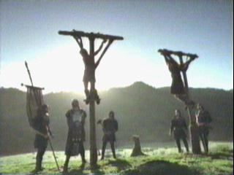
5. Fulfilled prophecies

Slide 8
6. Remarkable unity and coherence
40 authors
Took 1500 years to write

Slide 9
7. Its life-transforming power

Slide 10
8. Has answers to life’s ultimate questions
What is the Ultimate Reality?
What is a human being?
What happens after death?
What is the meaning of human history?
What determines right and wrong?

Slide 11
This PowerPoint presentation is available along with related materials and other PowerPoint presentations at http://home.snu.edu/~hculbert/ppt.htm

