Slide 1
What now? Case Studies – a unique teaching tool
Ministry, Church and Society
Southern Nazarene University

Slide 2
What’s a case study?
An open-ended actual story
No ending given
Brings chunks of reality into the classroom
A difficult problem, a dilemma without an obvious solution
Pioneered by Harvard business school
Forces us into a real situation where we have to answer: “What do we do now?"

Slide 3
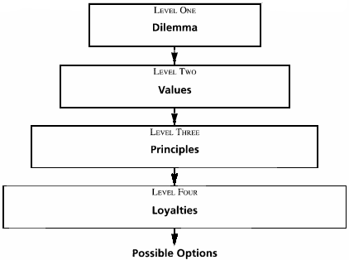

Slide 4
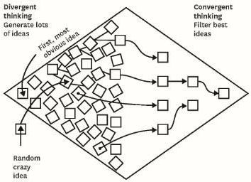
http://blogs.hbr.org/cs/2012/10/create_presentations_an_audien.html

Slide 5
Case studies in MCS
“Drink or not to drink”
When values you cherish are at odds with the expectations of those around you
“Racism in the church”
A local church gripped by unbiblical attitudes and actions
“Youth group sponsors and a stripper”
When church members may have made bad judgments in attempts at humor
“He walked away”
An attempt at sharing one’s faith doesn’t turn out like expected

Slide 6
Case Study #1: To drink or not to drink
Young American believer in France
http://home.snu.edu/~hculbert.fs/drinking.htm

Slide 7
When we are puzzling to non-believers
Alcoholic beverage is not key issue
This is not a “temperance” lesson
Key issue: A believer in a situation where others do not share, and perhaps are even puzzled by his lifestyle positions

Slide 8
The question for us
Question: What do I do in situations where my convictions are in direct opposition to other people's expectations?
http://home.snu.edu/~hculbert.fs/drinking.htm

Slide 9
This PowerPoint presentation is available along with related materials and other PowerPoint presentations at http://home.snu.edu/~hculbert/ppt.htm

