Slide 1
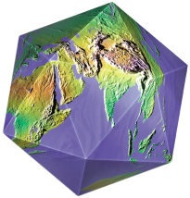
Lesson 8:
Pioneers of the
World Christian Movement
Howard Culbertson
Southern Nazarene University
Perspectives on the World Christian Movement

Slide 2
PIONEER: a person who is among the first to research and develop a new area of knowledge or activity
Perspectives on the World Christian Movement

Slide 3
Key word describing missionary pioneers?
Faithful!
Perspectives on the World Christian Movement

Slide 4
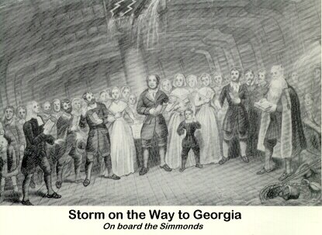
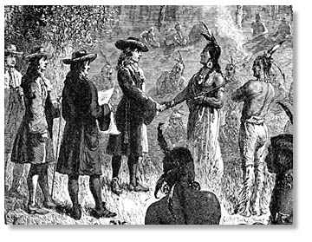
Moravians
Perspectives on the World Christian Movement

Slide 5
Moravians
“..if there is no passionate love for Christ at the center of everything, we will only jingle and jangle our way across the world, merely making a noise as we go.”
Count Nicolaus von Zinzendorf quoted by Colin Grant, Reader, p. 275
Perspectives on the World Christian Movement

Slide 6
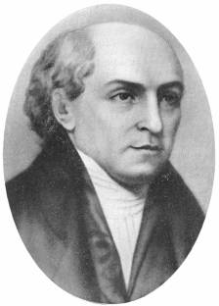
William Carey: British missionary to India
Church leader’s rebuke to Carey: “When God chooses to win the heathen, He will do it without your help or ours.”
Perspectives on the World Christian Movement

Slide 7
William Carey: “The Father of Modern Missions”
Does he merit that title?
Perspectives on the World Christian Movement

Slide 8
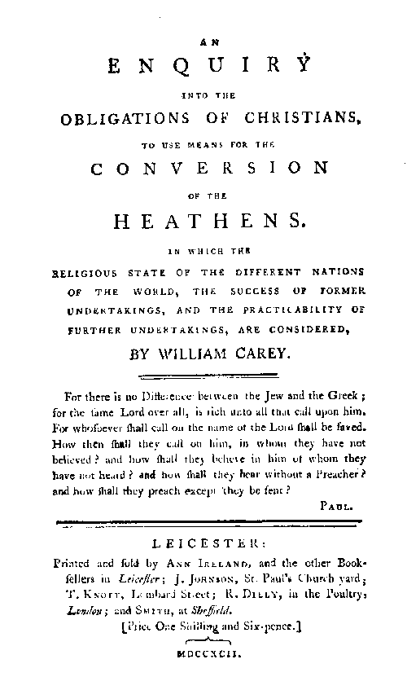
Spoke about establishing mission societies as a “means”
Graphically presented the world and presence of the church
Answered common objections to foreign mission work one-by-one
His wholistic approach became the Magna Carta for mission societies
Perspectives on the World Christian Movement

Slide 9
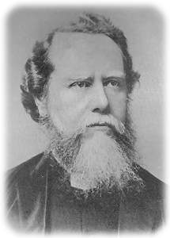
Hudson Taylor: Missionary to China
Passion to reach the unreached
Great example of contextualization
Perspectives on the World Christian Movement

Slide 10
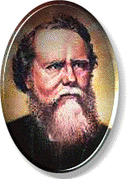
Hudson Taylor
A Chinese convert:
“What! For hundreds of years you have had these glad tidings and only now have come to preach it to us? My father sought after the truth for more than twenty years, and died without finding it. Oh, why did you not come sooner?”

Slide 11
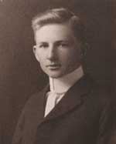
Cameron Townsend
An Indian’s question:
“How come God doesn’t speak my language?”

Slide 12
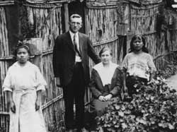

Cameron Townsend
Perspectives on the World Christian Movement

Slide 13

Donald McGavran, missionary to India
“God wants His lost children found!”
Perspectives on the World Christian Movement

Slide 14
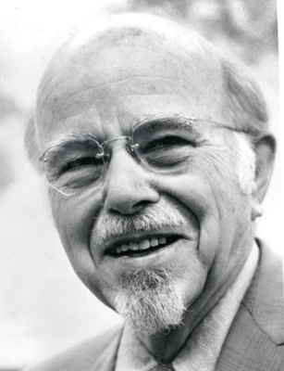
Donald McGavran (1897-1990)
How do whole peoples become Christians?
The gospel travels best along lines of existing relationships.
Normal church planting can only take place after the breakthrough into a particular group.
The Homogenous Unit Principle.
McGavran started both the church growth movement and the frontier mission movement.

Slide 15
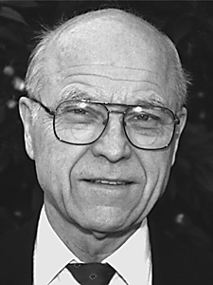
Ralph Winter
“It is clear that Jesus is referring primarily neither to geography nor walls of prejudice when he lists Judea, Samaria, and the ends of the earth… It seems likely he is taking into account cultural distance as the primary factor.”
Perspectives on the World Christian Movement

Slide 16
Ralph D. Winter
Presbyterian Missionary to Guatemala
Professor at Fuller School of World Mission
Speech at Lausanne Conference on World Evangelization, 1974: “Hidden Peoples.”
US Center for World Mission and William Carey International University, 1979

Slide 17
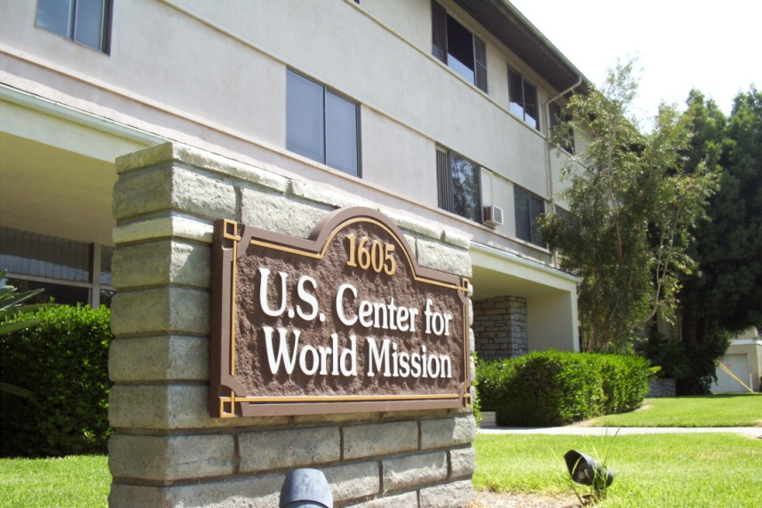
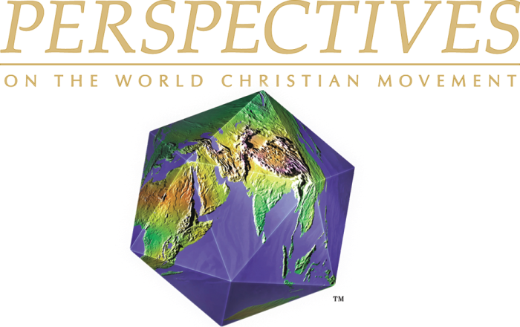
Ralph Winter
“… until we all recover from this kind of blindness, we may confuse the legitimate desire for church or national unity with the illegitimate goal of uniformity. ”
Perspectives on the World Christian Movement

Slide 18
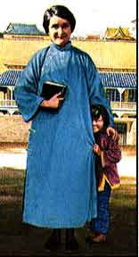
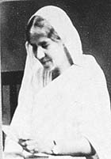

Women in Missions
Mary Slessor
Amy Carmichael
Gladys Aylward
Perspectives on the World Christian Movement

Slide 19
Amy Carmichael of Donavur
“Why don’t you concentrate on saving their souls?”
“I find their souls are very stubbornly attached to their bodies.”

Slide 20
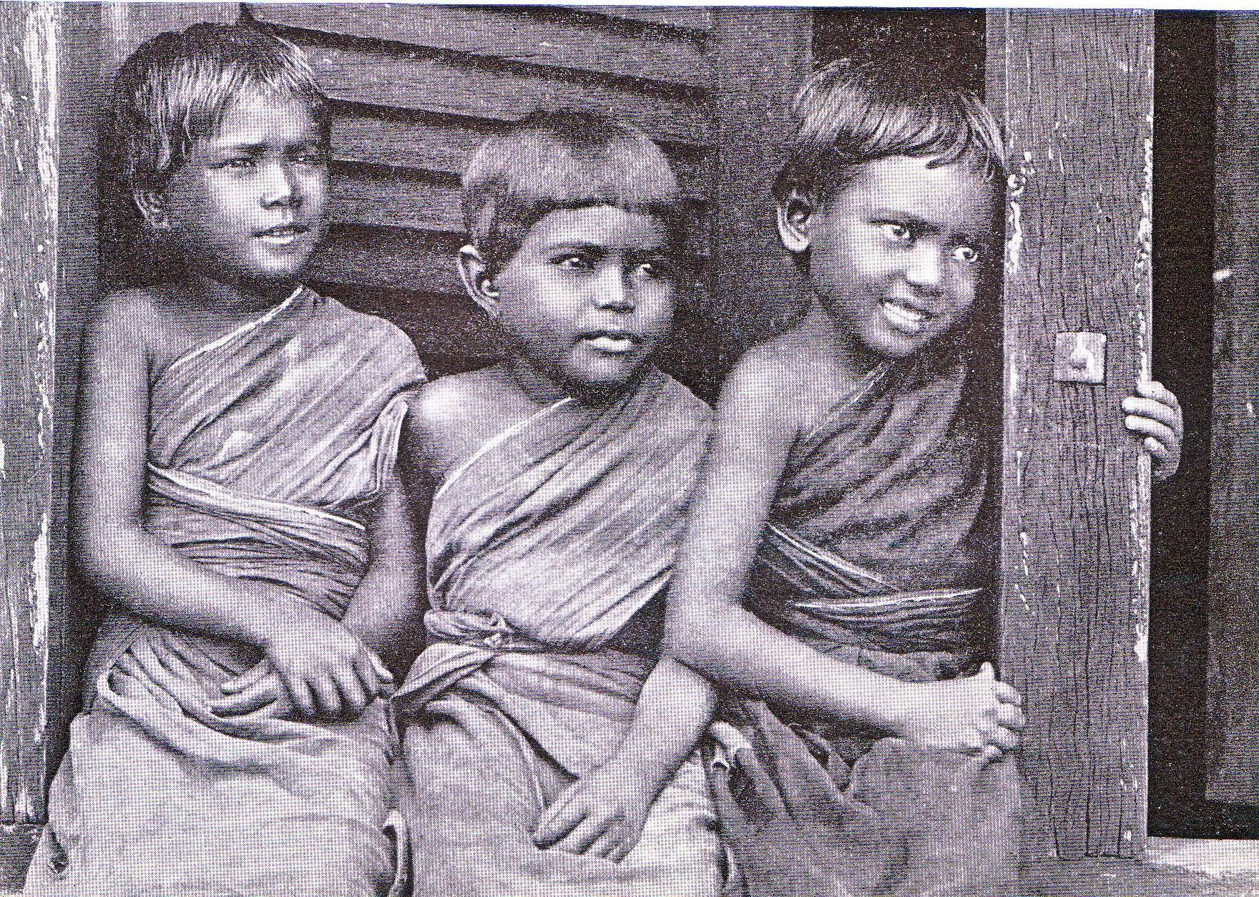
Three girls rescued from temple prostitution by Amy Carmichael

Slide 21
Mary Slessor was raised in a one-room home in Great Britain.
In 1876 went to Calabar (part of Nigeria) with United Presbyterians.
Became an insider among the Efik -- became “more African than the Africans”.
Planted churches and fought slavery, twin-killing, and other social evils.
Mary Slessor
(1848-1915)

Slide 22
Born in a poor home in London.
At age 26 applied to CIM, rejected.
Went to China by train
Founded an inn there.
Was appointed foot-inspector for Yangchen.
Adopted many orphans.
Gladys Aylward (1904-1951)

Slide 23
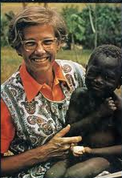
Helen Roseveare, missionary in the Congo
Helen showed how to really live out loving a people group.

Slide 24
Helen Roseveare

Slide 25
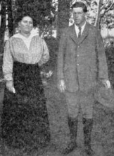
Farsightedness: Harmon and Lula Schmelzenbach
Perspectives on the World Christian Movement

Slide 26
What’s your takeaway from this evening?

Slide 27
This PowerPoint presentation is available along with related materials and other PowerPoint presentations at http://home.snu.edu/~hculbert/ppt.htm

