Slide 1
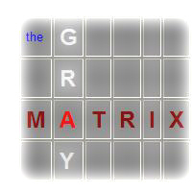
The Gray Matrix
…a tool for analysis and planning

Slide 2
Meeting People Where They Are
Spiritually
What they know and understand (about Gospel)
What they think they know – and misunderstand (about Gospel)
How they feel towards Jesus, the Gospel, Christians – and the Church
Their openness to change
Problems they face
Their interests

Slide 3
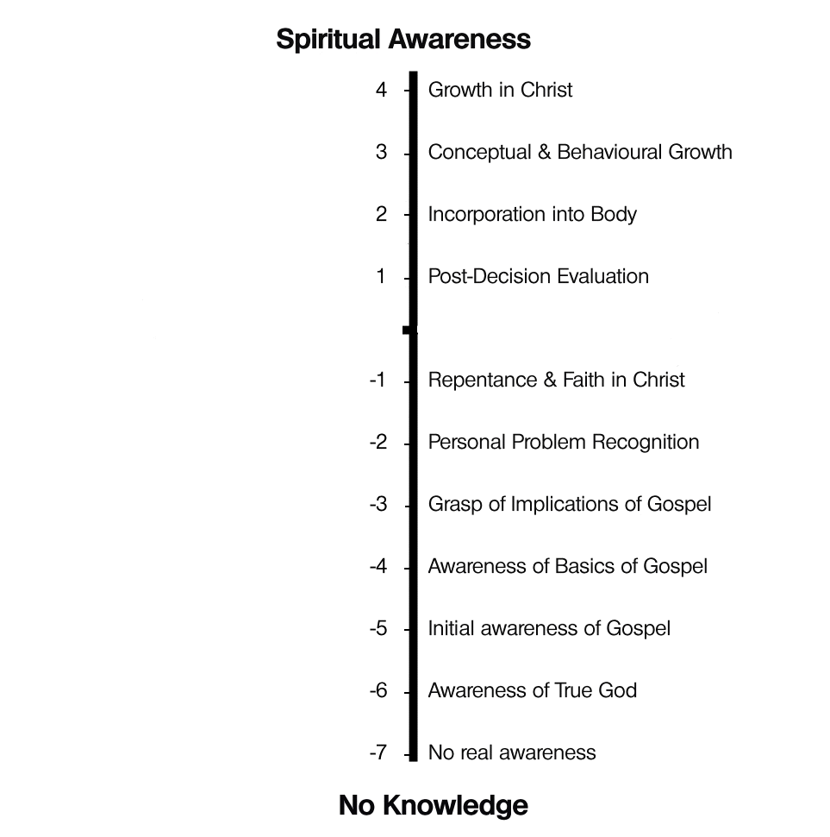
Knowledge-based scale
People generally start with “No real awareness” of God (-7)
As they receive input, their knowledge of the Gospel increases (-6 to -2)
By God’s grace they understand repentance and faith (-1) – and act on it
They begin to grow in knowledge and love of God
Based on knowledge of beliefs:
Triune God, the Creation event, The Fall, Revelation, Incarnation, Redemption, The Church, The Return of Christ

Slide 4
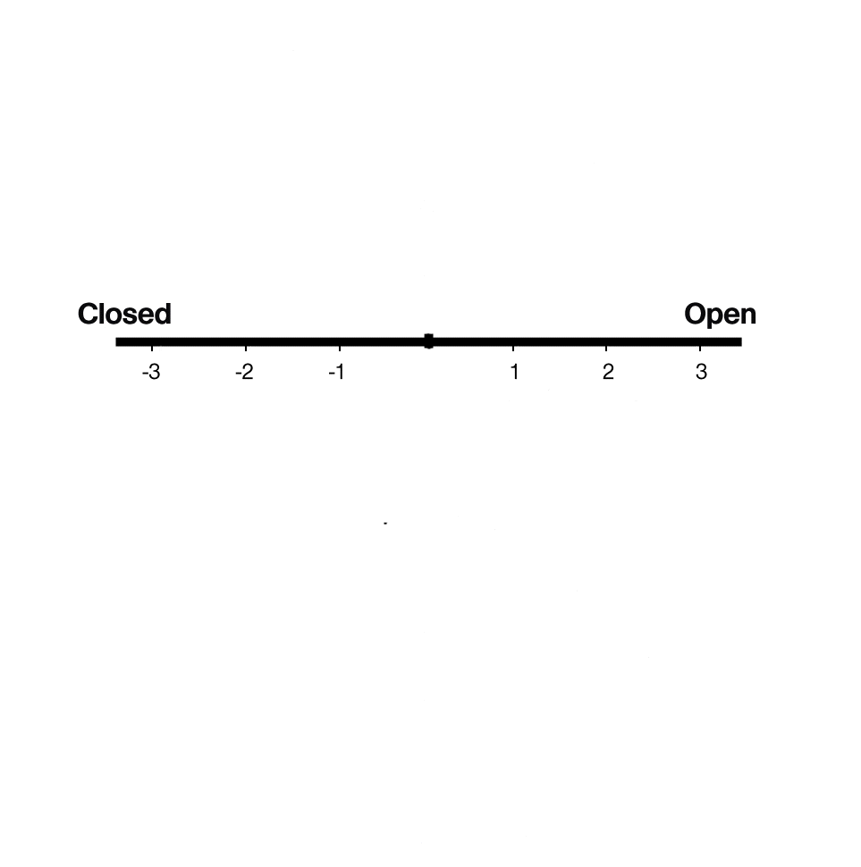
An “openness” scale
People’s attitude towards the Gospel
Recognition that attitude is not tied to knowledge
Openness depends on feelings and experiences

Slide 5
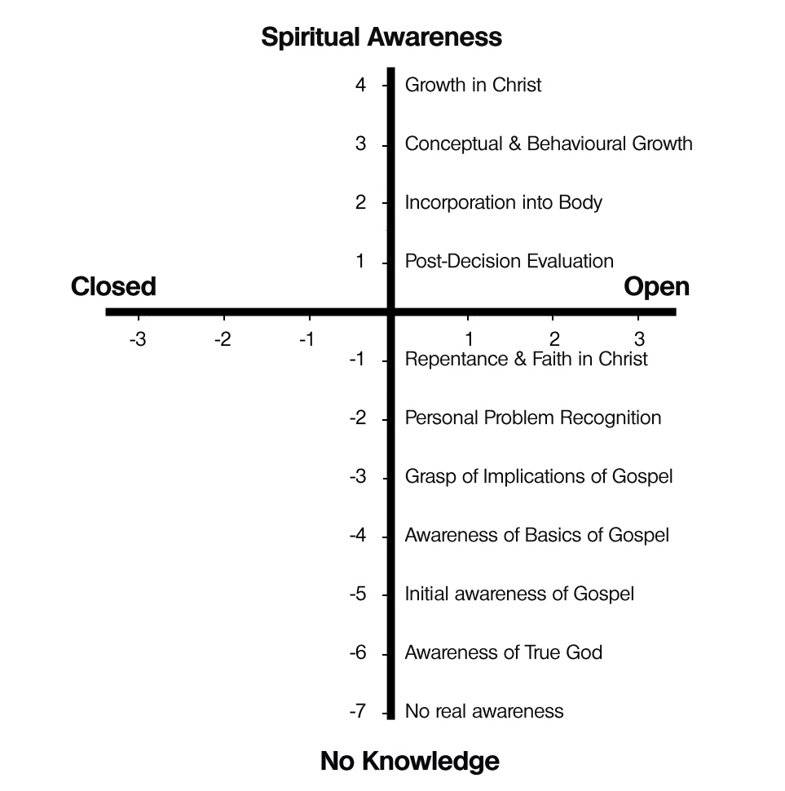
Knowledge + Openness
When we put the two scales together, we get a matrix:

Slide 6
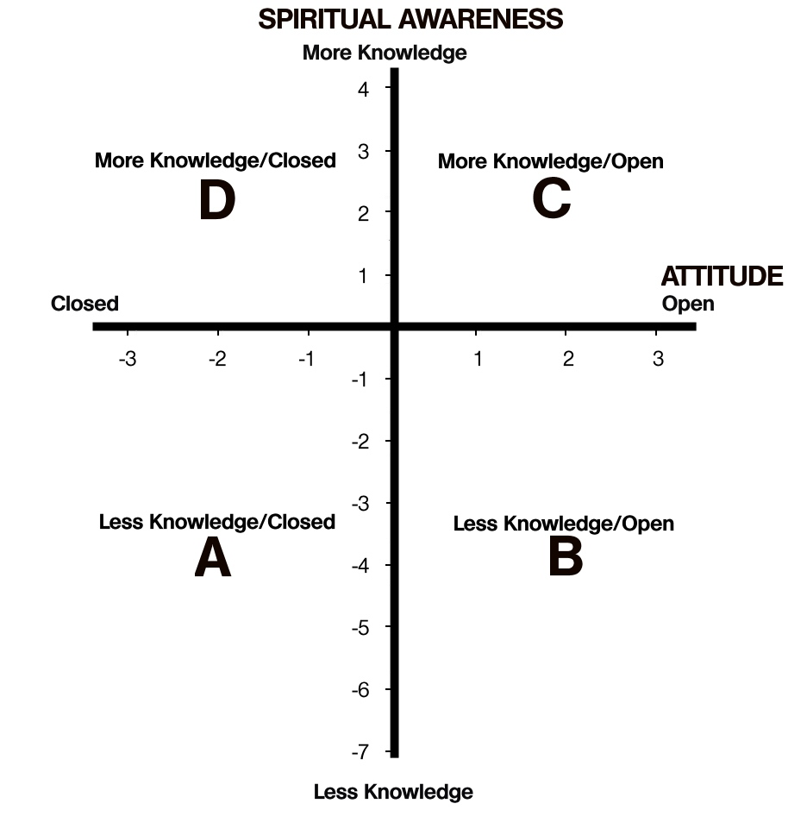
The Gray Matrix
4 quadrants (sectors)
A, B, C, and D
Each quadrant has a particular combination of characteristics

Slide 7
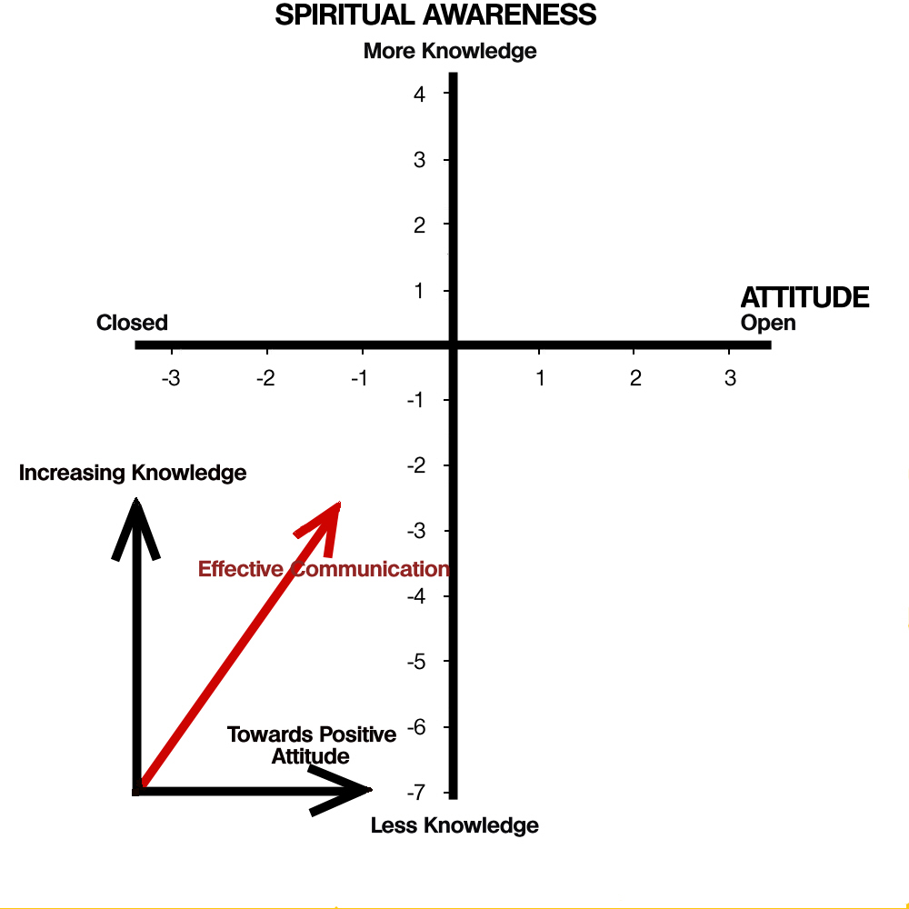
Effective faith communication
Helps people to become more open
Helps people to understand more
Recognizes that attitude may need to be changed first

Slide 8
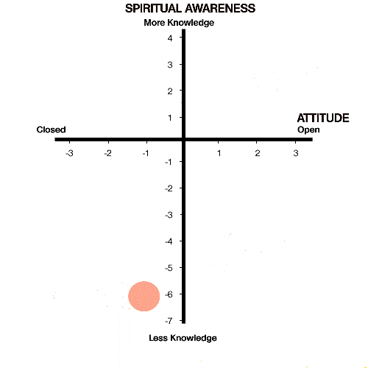
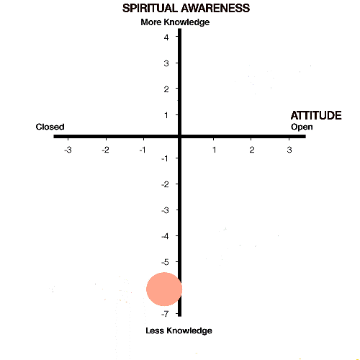
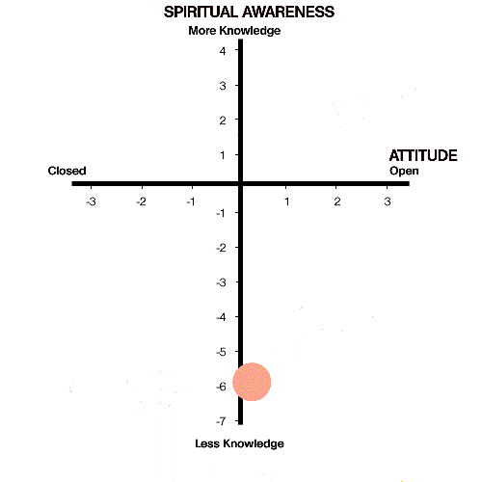
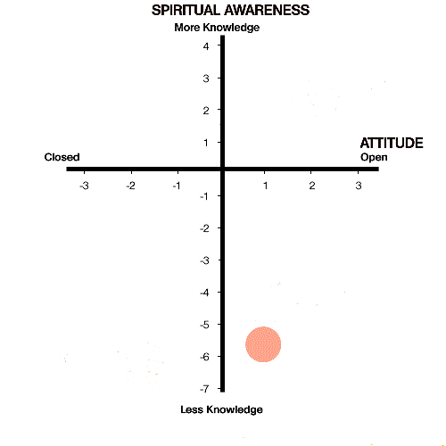
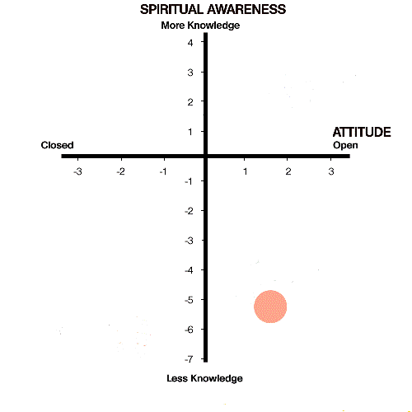
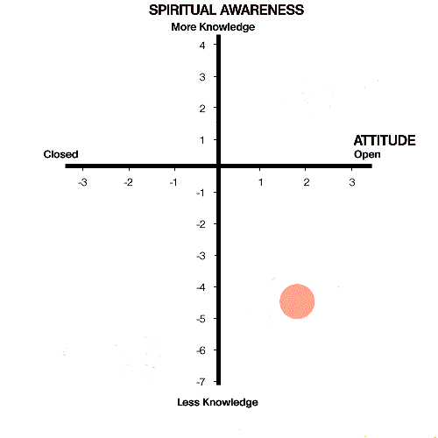
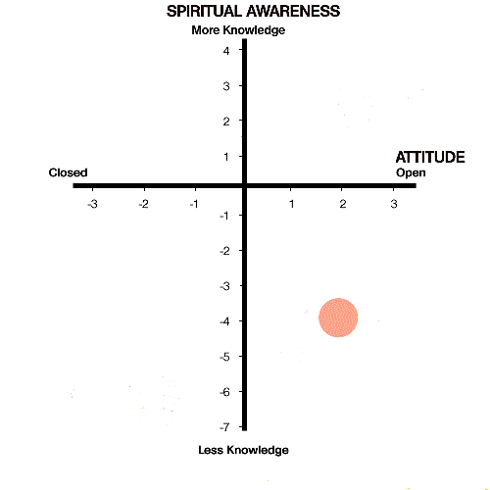
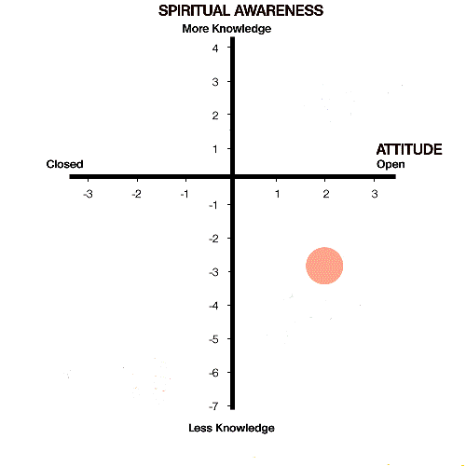
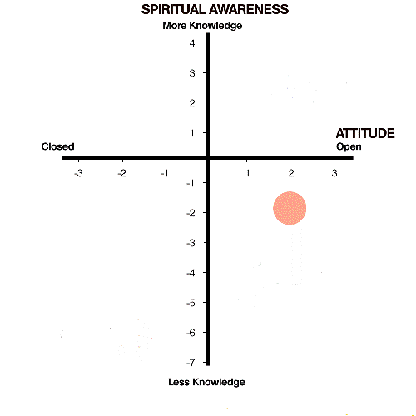
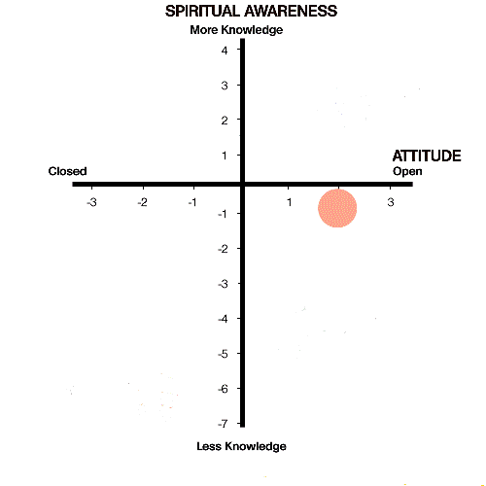
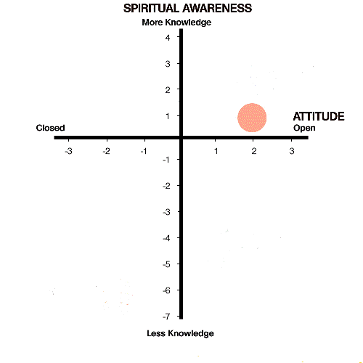
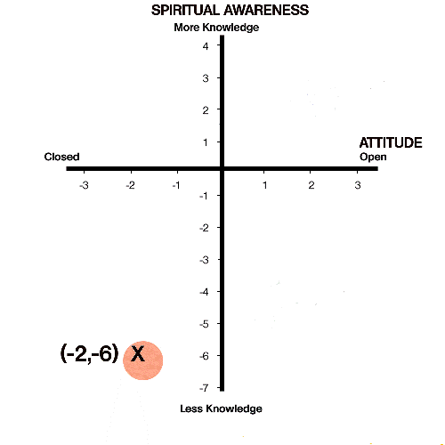
Laying a pathway

Slide 9
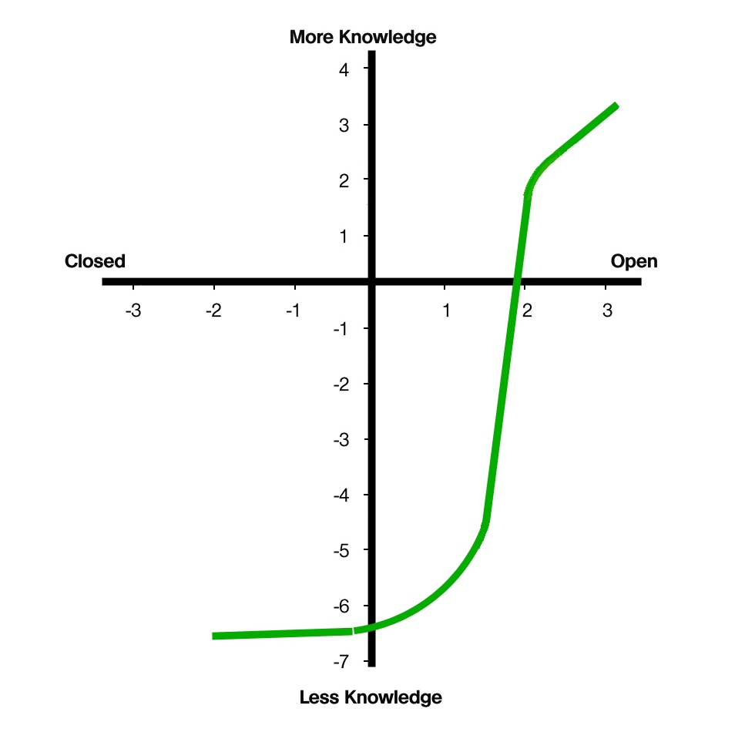
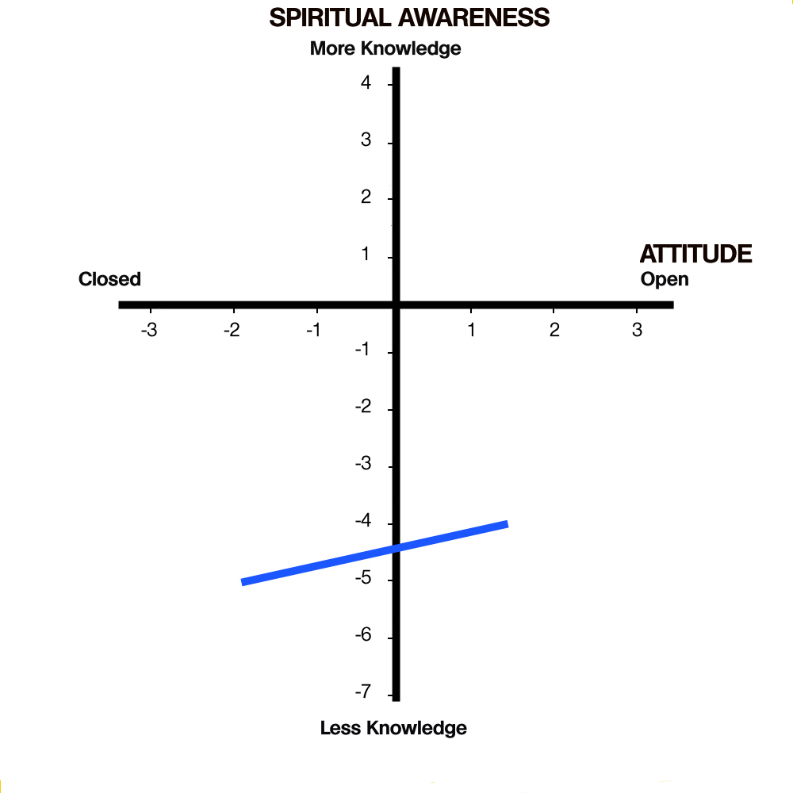
People and their paths in the matrix

Slide 10
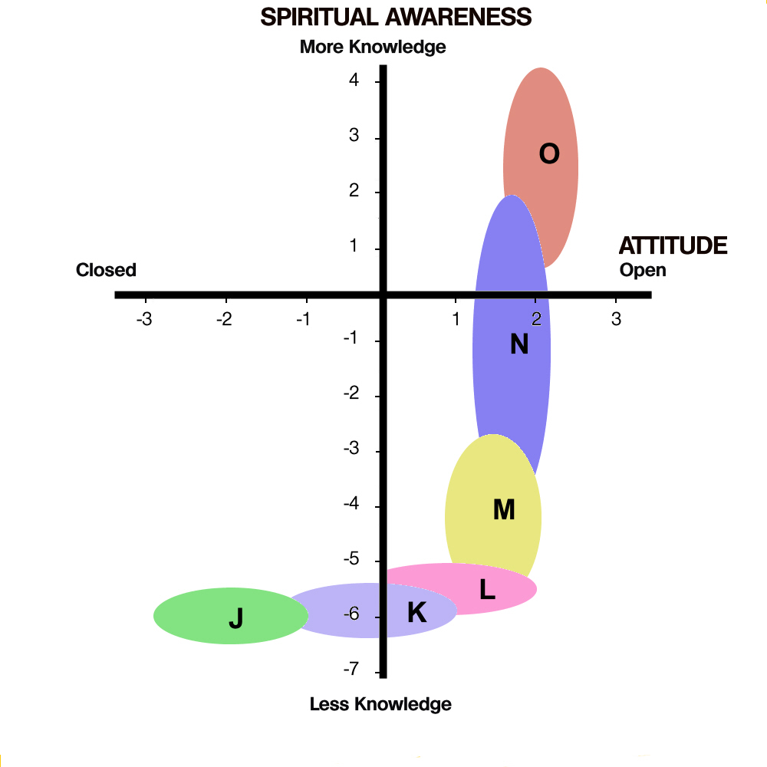
Pathway: Encounters

Slide 11
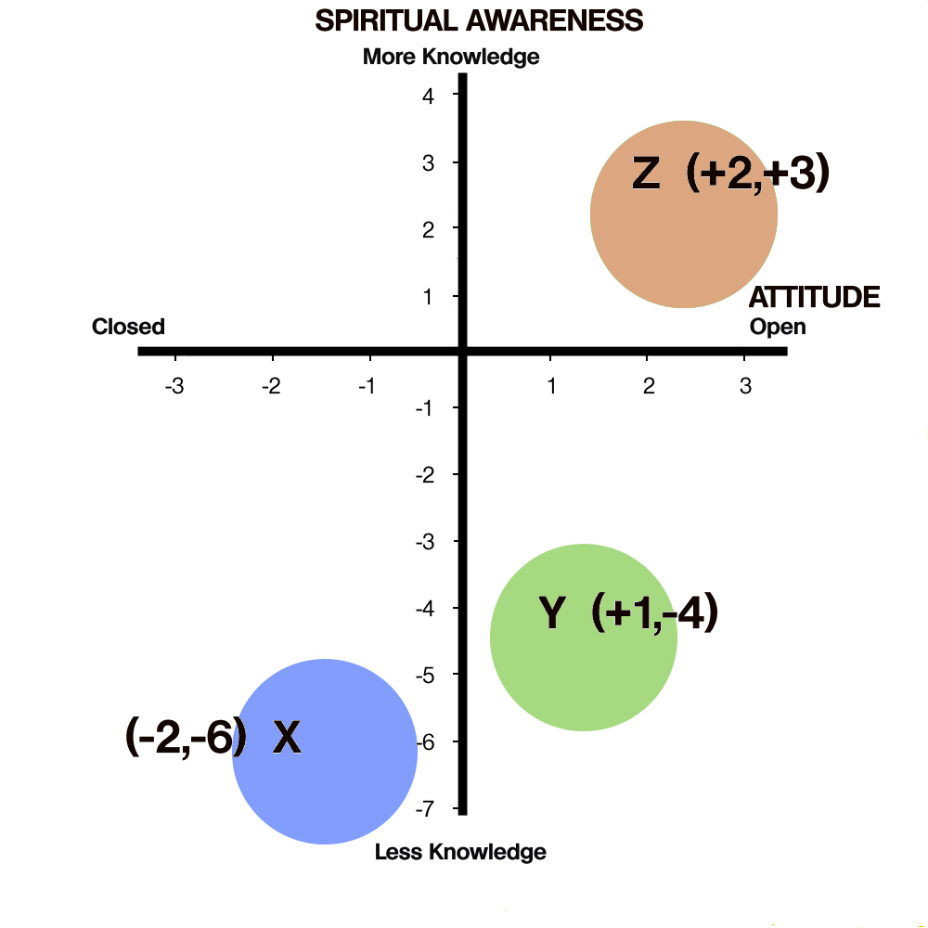
A common problem:
We say we are reaching people here
But in reality we are speaking to people here..
…or here

Slide 12
This PowerPoint presentation is available along with related materials and other PowerPoint presentations at http://home.snu.edu/~hculbert/ppt.htm

