Slide 1
Developing cultural awareness in short-term missionaries
Howard Culbertson
Southern Nazarene Universtity

Slide 2
Viewing culture as successively deeper levels of understanding -- diagram by Lloyd Kwast

Slide 3
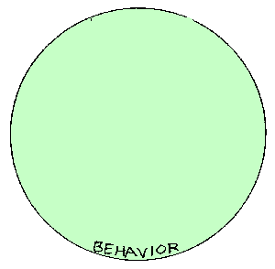

Slide 4
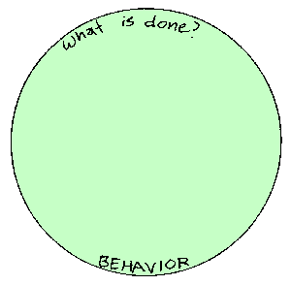

Slide 5
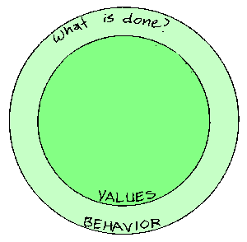

Slide 6
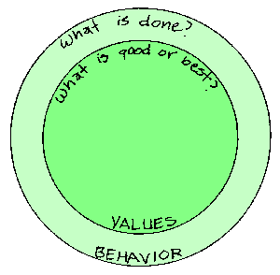

Slide 7
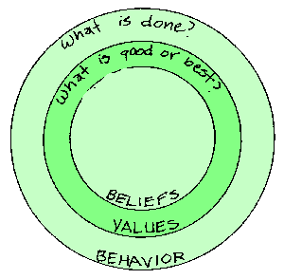

Slide 8
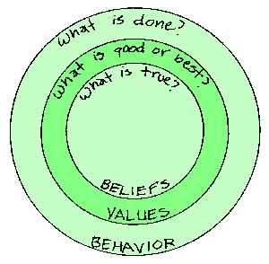

Slide 9
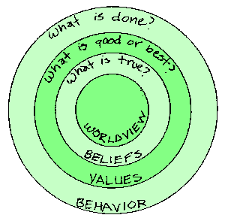

Slide 10
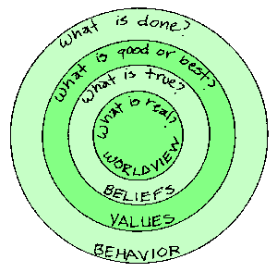

Slide 11
The iceberg analogy for culture
(with credit to Marc Siemens and Gary Weaver)

Slide 13
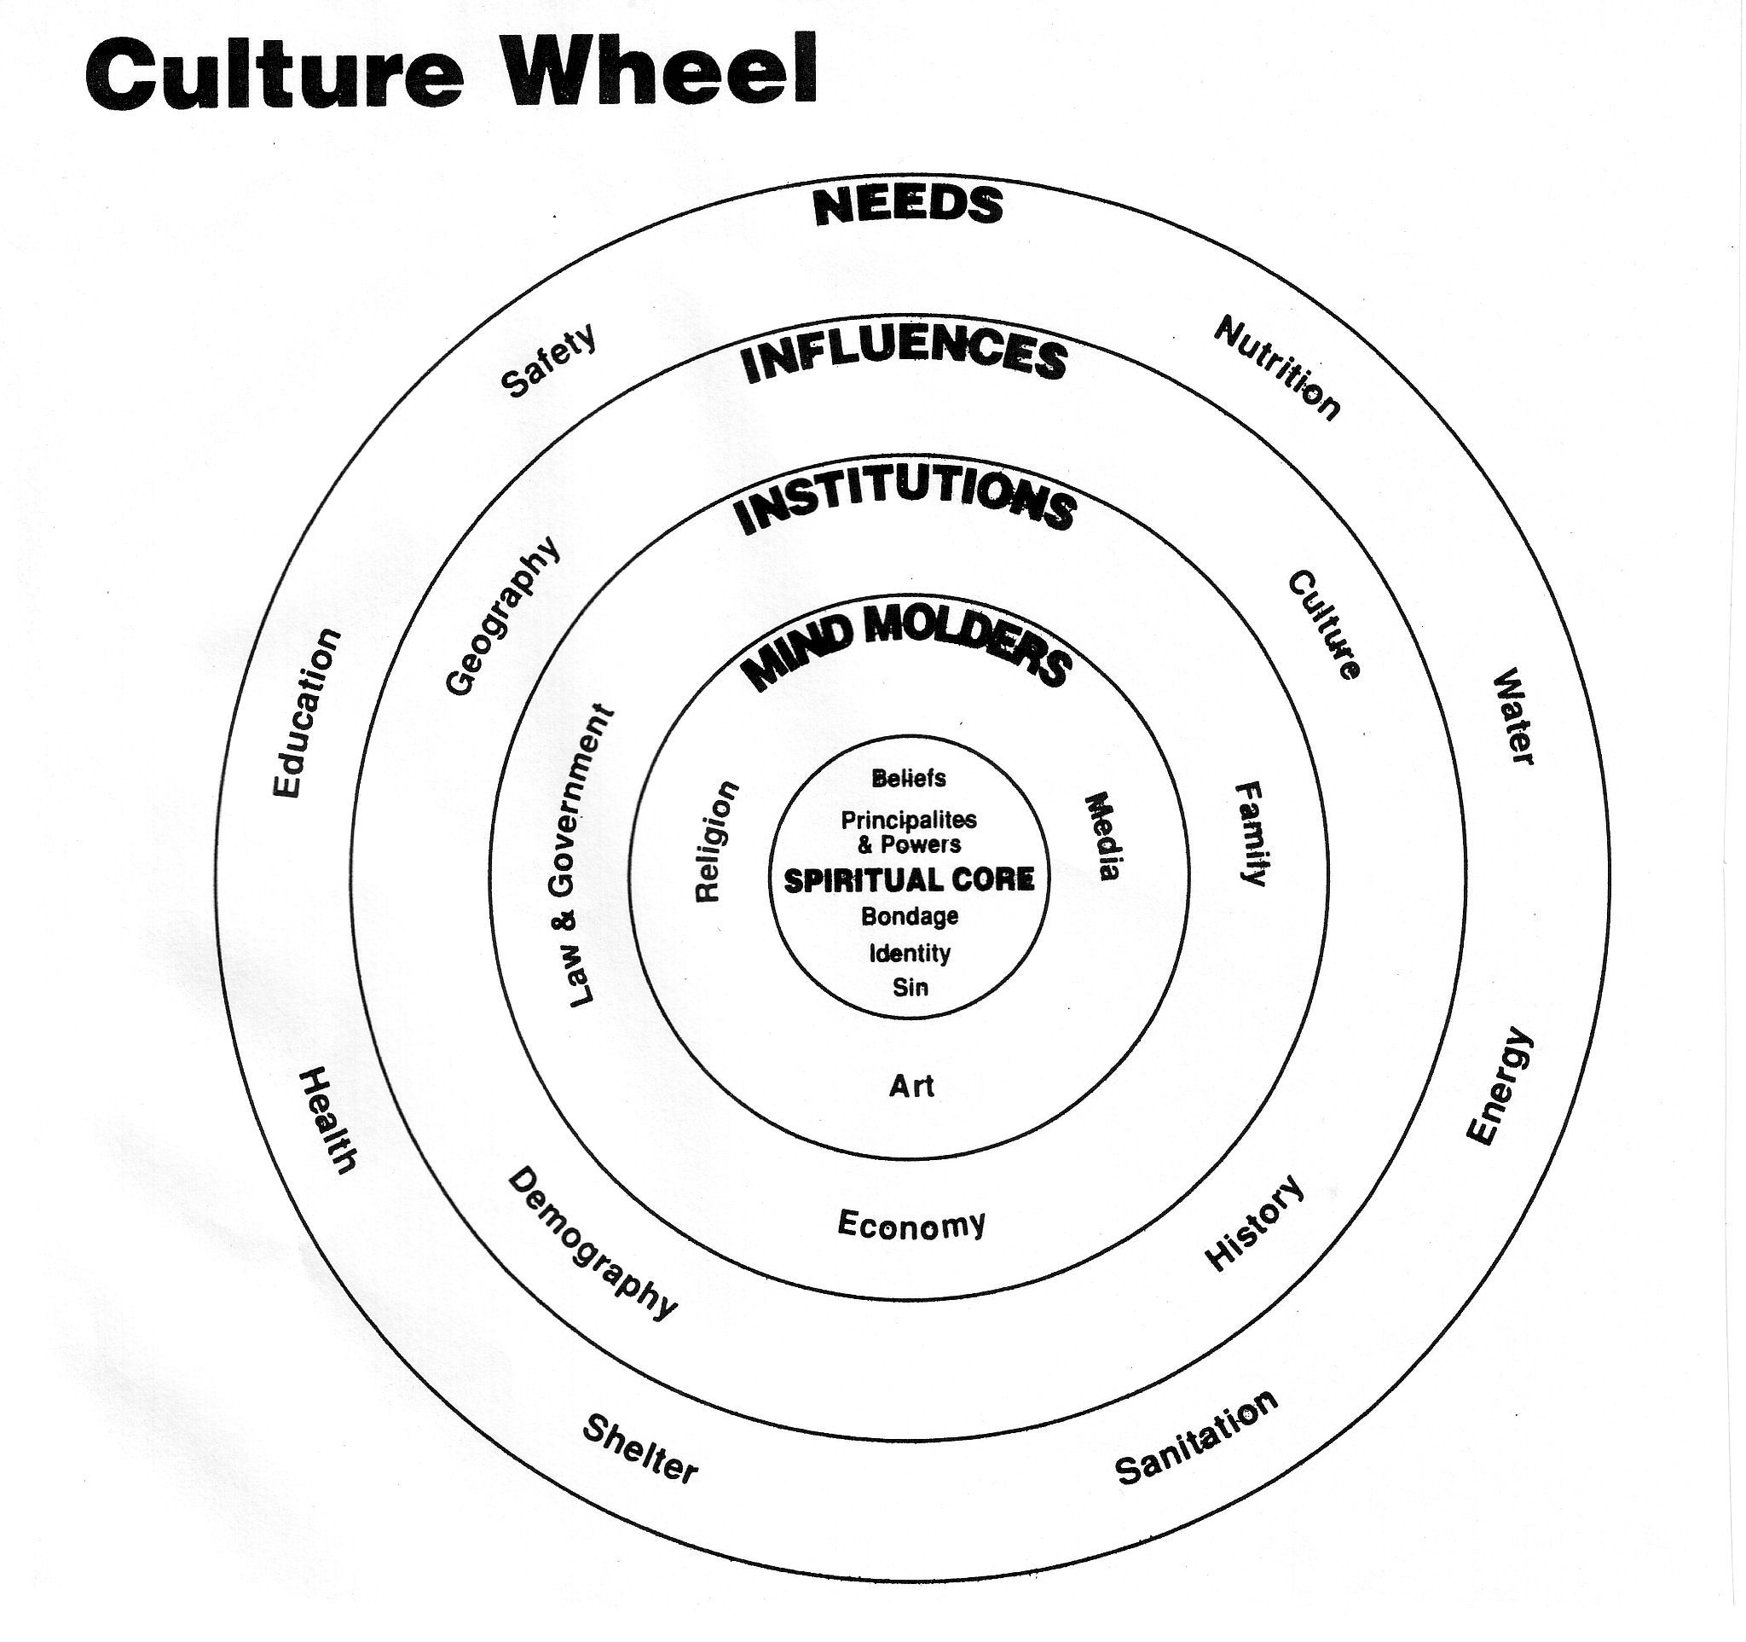

Slide 14
This PowerPoint presentation is available along with related materials and other PowerPoint presentations at http://home.snu.edu/~hculbert/ppt.htm

