Slide 1
Viewing Other Cultures: The Attitude Spectrum
Howard Culbertson
Southern Nazarene University

Slide 2
Attitudes toward other cultures The Continuum
Ignore Reject Tolerate Understand Embrace

Slide 3
Words to Keep in Mind
Ethnocentrism
Assimilation / acculturation
Syncretism / contextualization

Slide 4
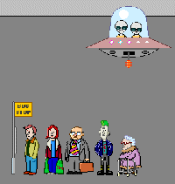
Ignoring

Slide 5
Ignore
Active or passive denial: “It may exist, but I don’t want to hear about it.”
Disdain or disregard for anything different
Example: American GI’s who never leave military bases in foreign country

Slide 6
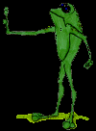
Reject
Thinks in stereotypes
Feelings of repulsion
Rebuff and repel on contact
Examples?
Any overtures are spurned

Slide 7
Tolerate
Adjectives used:
Irrational, rude, ignorant
How it’s managed
“I can survive this.”
“I don’t like it, but I can bear it.”
“It’s awful, but I will stomach it.”

Slide 8
Understand
Accept
Appreciate
Empathize with . . .

Slide 9
Embrace
“I love you for who you are.”
Welcome and even adopt
Integration
Incorporate

Slide 10
Question
How do we deal with those things in a culture which we think go against biblical principles?

Slide 11
Attitudes toward other cultures The Continuum
Ignore Reject Tolerate Understand Embrace

Slide 12
This PowerPoint presentation is available along with related materials and other PowerPoint presentations at http://home.snu.edu/~hculbert/ppt.htm

