Slide 1
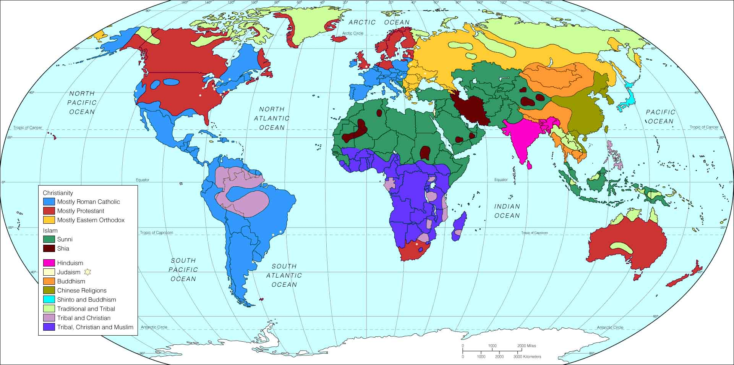
Religions of our world

Slide 2
This PowerPoint presentation is available along with related materials and other PowerPoint presentations at http://home.snu.edu/~hculbert/ppt.htm

