Slide 1
Contents of Bible books
Introduction to Biblical Literature

Slide 2
Historical books
17 books
Pentateuch
Pre-exile (before Babylonian conquest)
Post-exile (after return from Babylon)

Slide 3
Genesis – book of beginnings
Beginning of universe; beginning of human race; beginning of sin (how people preferred going their own way rather than doing God’s will); beginning of the Jewish people
Key chapters
Genesis 1-2 Creation
Genesis 3 Sin / First promise of Redeemer
Genesis 12 Abraham’s call

Slide 4
Exodus — Liberation (the way out)
Biggest event in Jewish history: deliverance from Egyptian slavery
Turning group of slaves into a functioning nation
Giving of the Ten Commandments and building of Tabernacle
Key chapter: 20 – The Ten Commandments

Slide 5
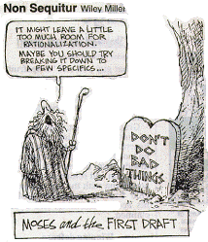

Slide 6
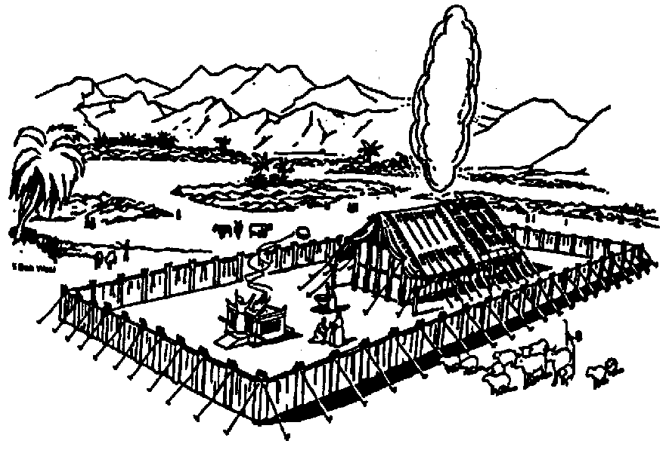
Leviticus
The Levites (priests) and their service in the Tabernacle:
Instructions for 5 offerings and 8 feasts
How may an unholy people approach a holy God?
Key verse: “Love your neighbor as yourself” (19:18)

Slide 7
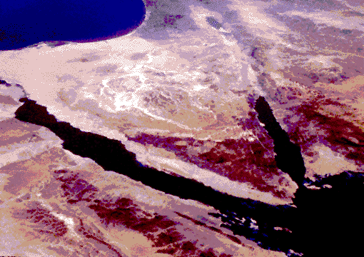
Numbers — (also called Book of the March)
Wilderness wanderings from Sinai to the border of Canaan -- a period of about 40 years

Slide 8
Deuteronomy — Moses’ last messages and songs
Book of Remembrance: Moses looks back over a century crammed with epoch-creating events
Deuteronomy means “second law”
Source for Jesus’ Great Commandment about loving God with all our heart, soul and body

Slide 9
Joshua —
Conquest of the Promised Land / fall of Jericho and Ai
Assigning portions of Promised Land to the tribal groups
Key chapter:
Joshua 24: “line in the sand”

Slide 10
Judges — Israel’s Dark Ages
350 years from Joshua’s death to crowning of first king: Saul
Key phrase: “Every man did what was right in his own eyes” (Judges 17:6)
15 judges (Gideon, Samson, Deborah)
7 apostasies, 7 servitudes, 7 deliverances

Slide 11
Ruth — establishes family line of David (the Messiah’s ancestor)
No place for racial prejudice in God’s Kingdom

Slide 12
I & II Samuel —
From Samuel’s childhood through Saul’s troublesome times and on through the reign of David
God’s people come to a turning point as monarchy is set up

Slide 13
Side note:
Question: Why I & II Samuel, I & II Kings and I & II Chronicles?
Answer: When translated into Greek, the writings took up one third more space than they did in Hebrew. The parchment scrolls on which they were written were limited in length.

Slide 14
I & II Kings: 400 years of the growth and then the decay of the kingdom
Begin with King David and end with the king of Babylon.
Open with building the temple / end with burning the temple
Open with David's first successor the temple to the throne — Solomon — and end with David's last successor — Jehoiachin — released from captivity by the king of Babylon.
I Kings has the story of Elijah; II Kings centers around Elisha.

Slide 15
Material in Chronicles
1. Reign of Solomon
2. Division of Kingdom
About 850 B.C.
3. Parallel History of the Two Kingdoms
4. History of Judah to the Captivity
(from about 721 B.C. to 586 B.C.)

Slide 16
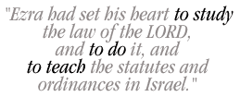
Ezra — Jewish restoration from Babylonian Captivity; 50,000 Jews return from exile to their homeland and rebuild Jerusalem and the Temple
Photo of Cyrus’ decree allowing temple to be rebuilt

Slide 17
Nehemiah — Nehemiah as new governor rebuilds walls of Jerusalem

Slide 18
Esther — A plot to exterminate the Jews
Divine deliverance of dispersed Jews who were destined to die; God in the shadows watches His own
Key verse: “Perhaps you have come to the Kingdom for such a time as this”

Slide 19
Wisdom literature
5 writings from the heart

Slide 20
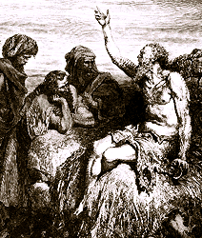
Job:
Why do the righteous suffer?
Job’s 4 “friends” attempt to explain what has happened to him
Key verse: Job 1:21-22

Slide 21
Psalms
Hebrew hymnal and book of prayers
Key chapters
Psalm 23 – the shepherd’s psalm
Psalm 51 – David’s cry for forgiveness after his adulterous relationship with Bathsheba

Slide 22
Proverbs
A manual for everyday living; moral and ethical implications of every area of life
Key verse: Proverbs 3:5-6
Key chapter: Proverbs 31 – Ode to a wonderful wife

Slide 23
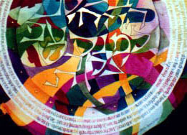
Ecclesiastes:
There is no meaning in life and creation apart from God; skeptical
Key verse: 2:11, 13; 12:13-14

Slide 24
Song of Solomon
The sacredness and purity of human love (perhaps a parable of divine love).
Key verse: 8:6-7

Slide 25
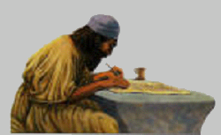
Prophetic writings
Two kinds of divisions:
Major / Minor
Pre-exile / post exile

Slide 26
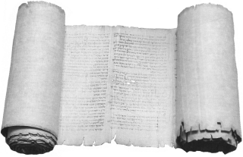
Isaiah —
More than any other Old Testament writing, looks forward to Messiah
Passionate portrayal of God’s righteousness and the necessity of faith
Key chapter: 53 -- “Suffering servant”

Slide 27
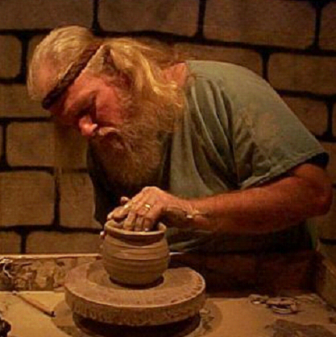
Jeremiah —
The God who avenges sin
Warns Judah that her sins will result in chastisement from the North (the Babylonians)
God is going to make a new covenant with His people
Uses lots of “object lessons”

Slide 28
Lamentations—
A lamenting over Judah's sins and the subsequent destruction she suffered
A sad cry for what has happened to God's people
An appeal for repentance

Slide 29
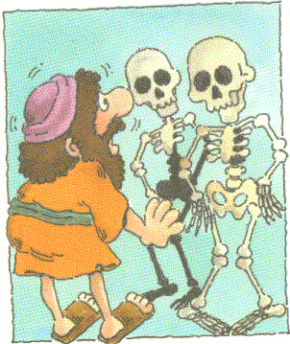
Ezekiel —
Foretells day when Israel will be reunited with her own king and will worship the one true God in the reconstructed temple.
Strange visions
Wheel within a wheel
Valley of dry bones

Slide 30
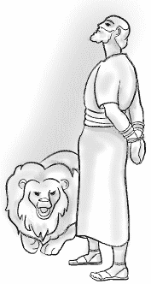
Daniel —
God’s people are being persecuted
Three Hebrew children in furnace
Daniel in lions’ den
In the Last Days God will bring about a Kingdom that will never be destroyed

Slide 31
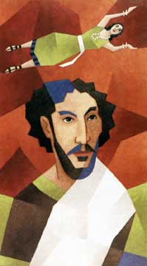
Hosea
An analogy of sin, forgiveness and grace built on Hosea’s relationship with his unfaithful wife, Gomer
Prophecy of Jesus, Mary and Joseph leaving Egypt and returning to Galilee

Slide 32
Joel— the prophet of Pentecost
The Spirit poured out on humanity
Invasion of crickets

Slide 33
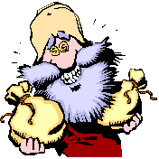
Amos — message to wealthy and religious leaders about their greed, selfishness, immorality, extortion, bribery and injustice

Slide 34
Obadiah —
Shortest book in Old Testament
Coming Day of the Lord
Prophecy against Edom

Slide 35
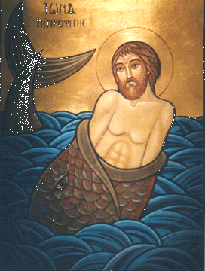
Jonah —
Missionary book of Old Testament
Let your heart be broken with what breaks God’s heart

Slide 36
Micah —
Prophecy of Bethlehem as Jesus' birthplace
Impending judgment

Slide 37
Nahum —
Downfall of Nineveh and vindication of Judah
God will punish arrogant and evil nations

Slide 38
Habakkuk —
A prophet's questions and complaints and God's answers
“The just shall live by faith" (2:4) which is quoted by Paul in his letter to the Romans

Slide 39
Zephaniah — coming day of the Lord; God's judgment on Judah; righteous remnant

Slide 40
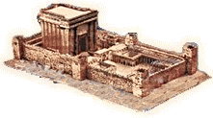
Haggai — Complete the Temple! “Is it right for you to live in luxurious homes when the Temple lies in ruins?”

Slide 41
Zechariah —
Visions reminiscent of John’s Revelation
Finish the Temple!
Prophecies of the Messiah
The 30 pieces of silver
The piercing of Jesus’ side with a spear
Jesus’ triumphal entry into Jerusalem on a donkey

Slide 42
Malachi —
Sin and apostasy of Israel
Passage on tithing – no one is living and giving like God wants

Slide 43
This PowerPoint presentation is available along with related materials and other PowerPoint presentations at http://home.snu.edu/~hculbert/ppt.htm

