Slide 1
Top 20 Unreached People Groups
Adapted from a presentation by Doug Lucas at Heartland MissionFest, Tulsa, OK

Slide 2
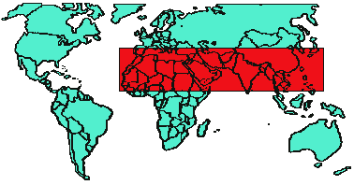
1) Geographical challenge
The 10/40 Window contains:
35% of global land mass
65% of world population
95% of those who have never heard the gospel
90% of world’s poorest people

Slide 3
The geographical challenge: Overwhelming!
Bhutan
Saudi Arabia
Chad
N. Korea
Libya

Slide 4
The geographical challenge: Unreached countries
23 countries with 10-50% professing Christians
35 countries with 1-10% Christian (including China and India)
29 countries (all within the 10/40 window) with less than 1% Christian

Slide 5
2) Urban Challenge
Growth of cities
1800: 4% urban
1900: 14% urban
2000: 51% urban
Growth of slums
1 billion people live in squatter settlements
Of the 2 billion people living in 3rd world cities, 40% are the “very poor”

Slide 6
3) Ideological challenge
Islam -- 1.1 billion
Hinduism -- 800 million
Buddhism -- 700 million
Druze
Baha’i
Ahmaddiyah
Sikhism
Jainism
Parseeism
Animism

Slide 7
4) Social challenge
Child issues
Abortion: 40 million per year
Child prostitution: 10 million currently, 1 million new/year
Malnutrition kills 35,000 children per day
Street children: 100 million
Victims of war: 1.5 million children killed in a recent decade; 4 million disabled, 12 million lost homes
More than 1.5 million AIDS infected children
Slavery: 100 to 200 million children
Drug addiction
Disease
TB - 30 million in 90s, 70% of prisoners in Russia have TB
Malaria - 3 million died in recent year, including 1 million children
AIDS
unknown in 1980, more than 6.5 million dead (25% children of HIV carriers), 2.3 million deaths in a recent year; 20 million known infected in Africa

Slide 8
5) The “People Challenge” Joshua Project list of Unreached Peoples
Our filter:
More than 10,000 pop.
Less than 5% Christian or <2% evangelical
1610 people groups fit that criteria
240 are “untargeted”
624 no church planting team
1152 have no reported church of at least 100 believers

Slide 9
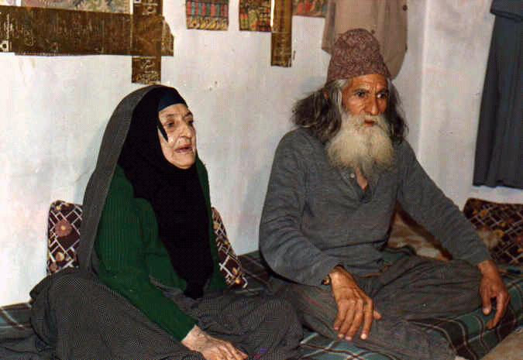
#20 Kurds
25 million
High profile in the news
Turkey, Iran, Iraq, Syria
One worker wrote, "In Turkey, where the largest contingent (40 percent) of Kurds live, the Kurdish are seen as a threat by the Turkish government. They have sought to assimilate the Kurds into Turkish society through forced resettlement. Until recently, it was a crime to speak Kurdish in public."

Slide 10
#19 Shuwa Arabs
1.5 to 2 million Sunni Muslims living mainly in central Chad (Africa)
Comprise one-third of the population of Chad
Less than 10 known believers among them
Only one missionary family working among them

Slide 11
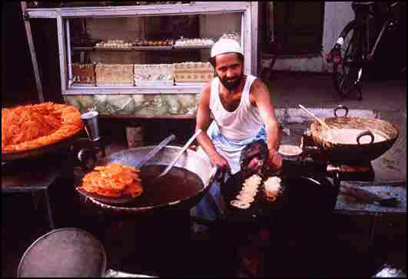
#18 Baloch
6 million speakers
Iran and Pakistan (Balochistan)
About 100 scattered believers among them
6 missionary couples are working among them
No established and continuing Christian fellowship

Slide 12
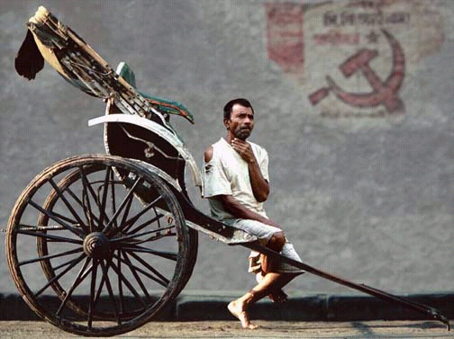
#17 Bengali
Nearly 200,000,000 in
Bangladesh and the Indian state of West Bengal
6th largest people group in the world
One of largest Muslim people groups
Seemingly always suffering.
The largest, least evangelized people group in the world.

Slide 13
#16: Gujarati
Population: 45 million (mostly in western India)
Less than one-half of 1% are Christian
7th largest language group on earth (spoken by 100 million people)
Only 1 adopting church

Slide 14
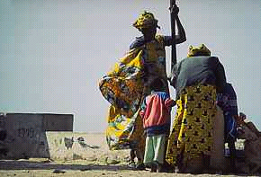
#15: Wolof
3 million
Very influential group in Senegal
Follow Muslim-African religions
Only 10-40 known believers worldwide
No known Wolof Christian fellowship anywhere in the world.

Slide 15
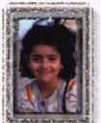
#14: Turkmen
Location: Afghanistan
Population: 1 million
Nomads by history; refugees by war
Muslim in religion

Slide 16
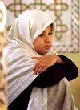
#13: Iraqi Arabs
17-18 million
One of the most misunderstood and hated groups on earth

Slide 17
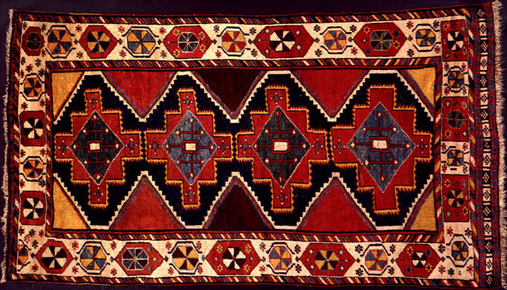
#12: Luri of Iran
Hostile to outsiders
Turkic, semi-nomadic, and therefore a minority group that is elusive and very inaccessible.

Slide 18
#11: Indonesian Groups
Staunchly Muslim people group
Population of 8 million
4th largest ethnic group in Indonesia
Homeland: Sumatra, "least evanglized island in the world"
According to Patrick Johnstone, “the most strategic unreached people in the Indo-Malay world.”

Slide 19
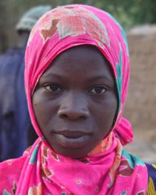
#10: Bambara
3.9 million people in Burkina Faso, Cote d'Ivoire, Gambia, Guinea, Mali, Mauritania, Senegal
Muslim and ethnic religions
4% Christian
About half never heard the gospel

Slide 20
#9: Southern Shilha Berbers of Morocco
Population: 3 million
Muslim
One of largest unreached groups
No church gatherings meeting in native tongue
Only handful of missionaries speak their language

Slide 21
#8: Kazaks in China
1.1 million
Nominally Muslim
Very few have ever heard the Gospel
Only a handful have come to believe in Christ.

Slide 22
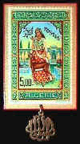
#7: Tajakant Bedouins of Algeria
Remote
Resources lacking
No Scripture
No Christian recordings
No “tent-maker” missionaries working among them
No known believers

Slide 23
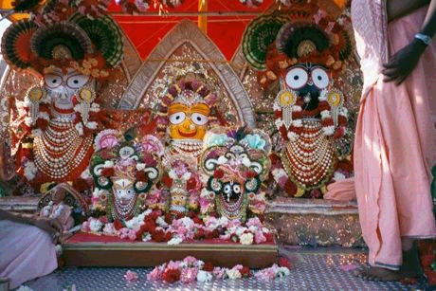
#6: Danakil of the Horn of Africa (Afar)
1.6 million scattered across 3 countries
3 organizations working among them

Slide 24
#5: Maldives
Small country with small population
99.9% Muslim
Christian activity is expressly forbidden
No Bible in their language, Divehi
50 or so believers in a country of 270,000

Slide 25
#4: Hazara of Afghanistan
Population: 2 million
100% Muslim
Make up 20% of Afghanistan
No scripture, but there are radio broadcasts

Slide 26
#3: Muslims of Bosnia
1.3 Million Muslims
Victims of war, injustice, ethnic cleansing
200,000 dead
100,000 were children
Little or no hope
High unemployment

Slide 27
#2: The Lao of Laos
3 million Buddhists and animists
Maybe 3% Christian
Over 1 million have never heard the gospel for the first time

Slide 28
#1: Riffi Berber of Morocco
1.5 million
99.99% Muslim
Maybe 30 believers

Slide 29
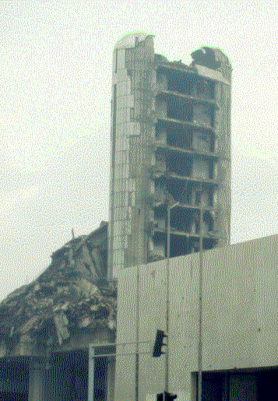
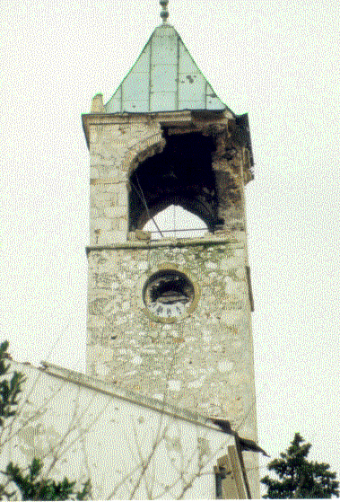
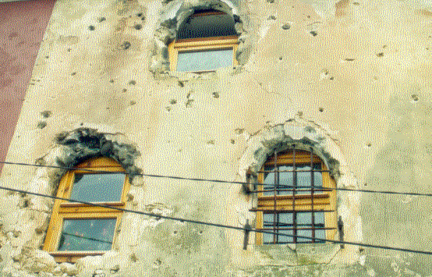
Isaiah 54:3 - A promise to claim
“For you will spread abroad to the right and to the left, and your descendants will possess the peoples and will people the desolate cities.” (RSV)

Slide 30
No valley is too isolated
...like the remote, unevangelized Kingdom of Mustang on Nepal’s northern border

Slide 31
No island is too distant
...like the yet-unreached Maldive Islands in the Indian Ocean

Slide 32
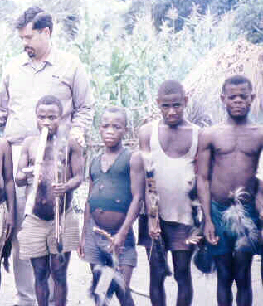
No forest is too dense
. . . like the Congo jungles where the Pygmy people live

Slide 33
No mountain is too inaccessible
. . . like the remote and harsh Tibetan plateau of central Asia

Slide 34
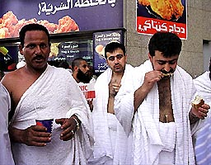
No city is too fortified
. . . like Mecca where no Christian is allowed to set foot

Slide 35
No desert is too hostile
...like the Saharan oases in Algeria where the Mzab Berber peoples live

Slide 36
We won’t reach them by accident
We must intentionally . . .
Pray
Give
Go
Short-term
Long-term

Slide 37
This PowerPoint presentation is available along with related materials and other PowerPoint presentations at http://home.snu.edu/~hculbert/ppt.htm

