Slide 1
Relational Evangelism
and articulating your testimony of faith

Slide 3
The Gospel: the good news, the divine message of salvation in Christ Jesus
Evangelism: the communication of that message
So, how is that done?

Slide 4
Isn’t “presence evangelism” enough?

Slide 5
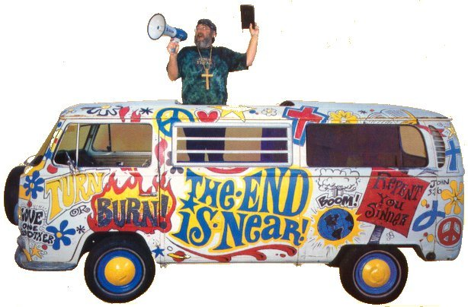
Evangelistic approaches
Mass
Inspirational
Settings
Invitations in local church services
Crusade-type events
One on one
Graphic by permission of Outreach Marketing, Inc.

Slide 6
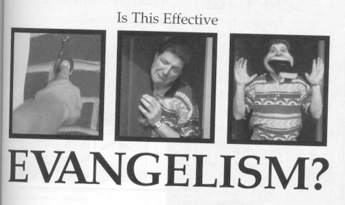
Does personal evangelism have to feel so impositional?
Sharing your faith shouldn’t be hard on your neighbor’s dental work
Graphic from an ad for Asbury Theological Seminary

Slide 7
“Faith does, on occasion, arise -- partly because of us and partly in spite of us” -- Brueggemann

Slide 8
One on one evangelistic approaches
Cup of cold water – expressing tangibly who Christ is
Invitational – “come with me”
Prophetic – “the Bible says”
Apologetic – point by point logic
Testimonial –
“One thing I do know: I was blind but now I see”
Relational – friendships

Slide 9
Relational evangelism
Evangelism that is intentional about bringing the Good News to someone in the context of a relationship
A majority of believers have come to faith in the context of a network of friends and family

Slide 10
Relational ministry isn’t a monorail event in which content is the only issue

Slide 11
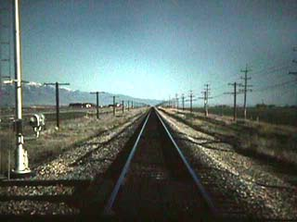
Relational evangelism’s two rails
Content (Gospel)
Incarnational (Our lives)

Slide 12
So, what’s incarnational about it?
The unbeliever comes to see Christ through His incarnation in the believer
Latin lesson: incarnation = “to make flesh; infleshment”

Slide 13
The content rail Gospel definition
Example gospel presentations
Evangelism explosion
God, Human beings, sin, grace, salvation
Four spiritual laws
Roman road
Gospel bracelets
Incarnational rail
Content rail

Slide 14
Four spiritual laws
God loves you and wants to establish a relationship with you
John 3:16
Sin separates you from God
Romans 3:23; 6:23
Jesus is the “bridge”
Romans 5:8
You must come to Christ and accept His lordship
Romans 10:9-10

Slide 15
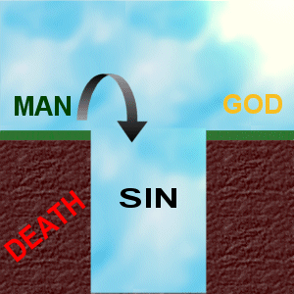
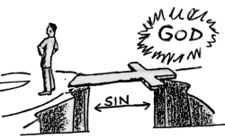
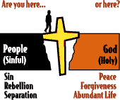
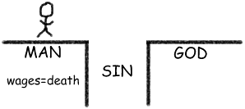

Slide 16
Roman Road
Romans 3:23
Romans 6:23
Romans 5:8
Romans 10:9-10

Slide 17
The incarnational rail
“We have souls that thrive in the warmth of kindred spirits. . . .God wired us this way, and because of that wiring we have the capacity for relationships” --Doug Fields
Incarnational rail
Content rail

Slide 18
Relational or incarnational evangelism:
Is step-by-step (but not the step-by-step of the prophetic “the Bible says” approach)
Evangelism strategist George Hunter:
“Conversion typically results from a ‘chain’ of experiences. The number of significant experiences in that chain is typically about 30 links.”
Relational evangelism creates those links

Slide 19
What were the links in your life?

Slide 20
Relational or incarnational evangelism:
Its intentional focus on friendship places a high value on people
“Every person has a right to hear the Gospel in a way that they can understand” – Jim Rayburn, Young Life
Earns you the right to be heard
Relationship produces:
Respect
A sense of safety
Conviction that you care

Slide 21
Recognizes God’s prevenient grace is always present
Latin lesson: pre-venir = grace that “comes before”
The Lord goes before us and prepares the way

Slide 22
Relational or incarnational evangelism:
Is an intentional transforming journey involving a process
Takes patience

Slide 23
The listening part of relational evangelism
Listen. Listen. Listen . . . And really hear.

Slide 24
Relational speech
Be simple
Never underestimate other people’s intelligence
Never overestimate their knowledge

Slide 25
Relational speech
Makes Christ central
“My propositional truths are more correct than your propositional truths”
Looks to take conversation to a deeper level
“Wouldn’t you like to believe in something?”
“Does God (or a Higher Power) seem personal to you?”

Slide 26
Where relational evangelism can go wrong
Wrong motivations
Notch on the gun
An extremely thin covering of “relational” on our evangelism
Ego trip
Examples?

Slide 27
Where relational evangelism can go wrong
Losing sight of the goal
The human relationship becomes the end
“It makes me a little queasy to think about all the junk that gets tossed our way in the name of ‘relational evangelism’“-- Art Rogers

Slide 28
Where relational evangelism can go wrong
Assuming our ”presence” is enough - never using the content rail
Danger: Giving the impression that we are the source of our spiritual life

Slide 29
“I’m not going to suggest a new formula, because . . . techniques aren’t the most effective, especially for friends.
“Have you ever thought of looking more deeply at the life of Jesus?
“If you live by the same priorities and values that He had, you will find evangelism happening naturally. It becomes a lifestyle and not a project.”
Out of the Saltshaker, by Becky Pippert

Slide 30
Prayer must blanket incarnational evangelism
Prayer for:
Communicator
transparency
Message
clarity
Recipient
responsiveness
Fasting and Prayer

Slide 31
Relational Evangelism
and Articulating Your
Personal Testimony

Slide 32
This PowerPoint presentation is available along with related materials and other PowerPoint presentations at http://home.snu.edu/~hculbert/ppt.htm

