Slide 1
Cultural Anthropology: some big names
Howard Culbertson
Southern Nazarene University

Slide 2
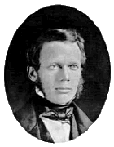
Lewis Henry Morgan 1818-1881
A 19th century scholar who developed the evolutionary approach
Pioneered the comparative study of culture

Slide 3
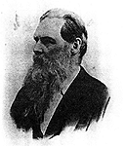
Sir Edward B. Tylor 1832-1917
Provided a still-valid definition of culture: that complex whole which includes knowledge, belief, art, morals, law, custom, and any other capabilities and habits acquired by man as a member of society.
Key theorist in the anthropology of religion

Slide 4
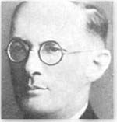
Bronislaw Malinowski 1884-1942
Outlined the biological and psychological needs of people fulfilled by culture
Pioneered the participant observation method

Slide 5
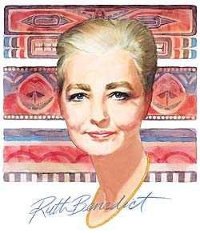
Ruth Fulton Benedict 1887-1948
Wrote “Patterns of Culture”
Viewed cultures as coherent patterns

Slide 6
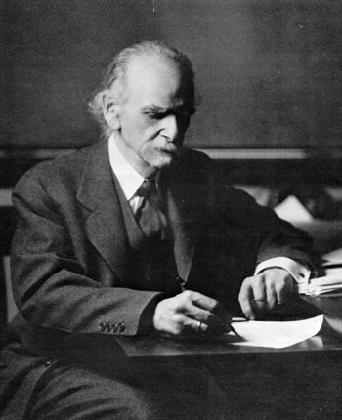
Franz Boas 1858-1942
Set high standard for excellence in fieldwork
Developed the idea of cultural relativity
Discredited then-dominant theories of racial superiority

Slide 7
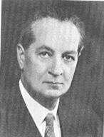
A.R. Radcliff-Brown 1881-1955
Developed the structural-functional approach to look at how each aspect of society contributes to the maintenance of the whole

Slide 8
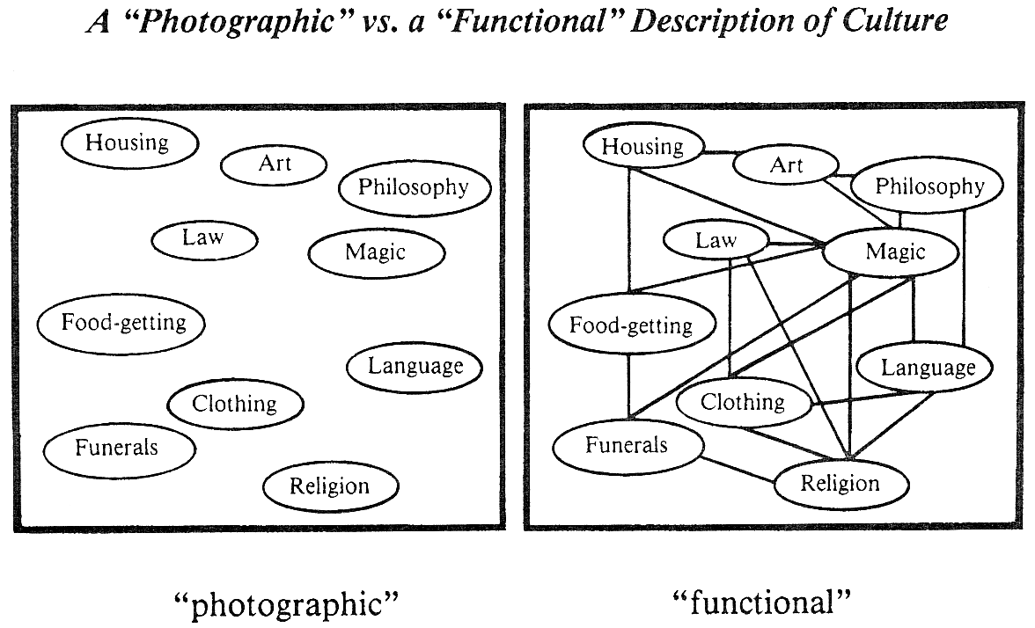

Slide 9
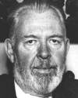
Ralph Linton, 1893–1953
Insights into process of acculturation
Influenced development of the culture-and-personality school of anthropology
Introduced terms "status" and "role"
The Tree of Culture (1955)

Slide 10
Julian H. Steward 1902-1972
Founder of the cultural ecology approach that focuses on the interactions of cultures with their environments

Slide 11
Leslie White 1900-1975
Developed the cultural materialist approach with focus on how the techno-economic aspects of culture determine the social and ideological spheres

Slide 12
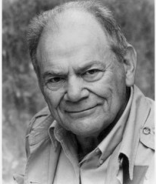
George Murdoch 1897-1985
Empiricist – senses are primary knowledge source
Came up 70 or so “cultural universals”

Slide 13
Margaret Mead 1901-1978
A “founding mother” of anthropology
Pioneered the cross-cultural study of personality

Slide 14
This PowerPoint presentation is available along with related materials and other PowerPoint presentations at http://home.snu.edu/~hculbert/ppt.htm

