Slide 1
Developing cultural awareness in short-term missionaries
Howard Culbertson
Southern Nazarene University

Slide 2
Short term versus long term
Short-termers generally do not get second chance opportunities

Slide 3
How do we get beyond . . . ?
Don’t drink the water
Don’t go out alone; groups of 4 with 1 being a male
Don’t smile at males on the street whom you do not know

Slide 4
How do we keep from . . . ?
Hardening stereotypes
Reinforcing ethnocentrism

Slide 5
Can we make sure they do not come back saying . . . ?
“I need to be a great deal more thankful for all that I have”
“They’re just like us”

Slide 6
CQ
What are possible phrases for which “CQ” could be an acronym?

Slide 7
Culture quotient
Cultural intelligence

Slide 8
CQ= culture quotient
Culture quotient / Cultural intelligence
Came into use about 4 years ago (Harvard Business Review)
Widespread now in business world
Short-term missions application
David Livermore’s Serving with Eyes Wide Open (2006)

Slide 9
Culture Quotient
Cognitive (the “head”)
Physical (the “body”)
Emotional/Motivational (the “heart”)

Slide 10
Viewing culture as successively deeper levels of understanding -- diagram by Lloyd Kwast

Slide 11
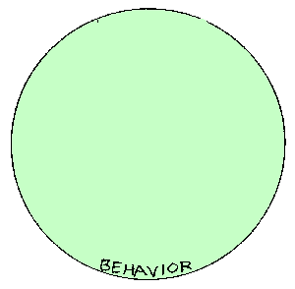

Slide 12
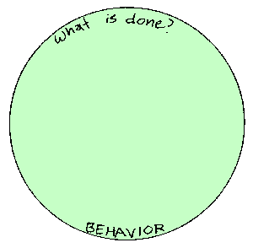

Slide 13
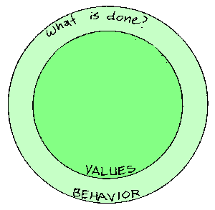

Slide 14
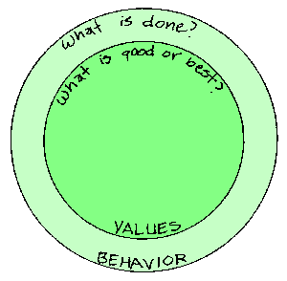

Slide 15
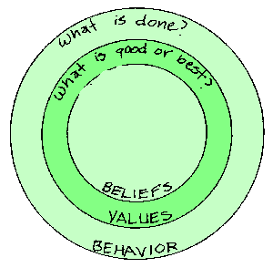

Slide 16
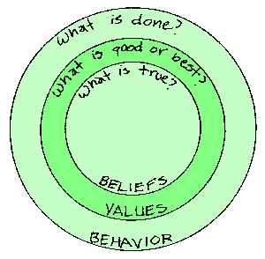

Slide 17
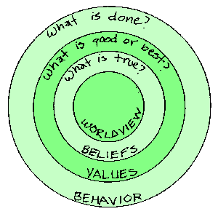

Slide 18
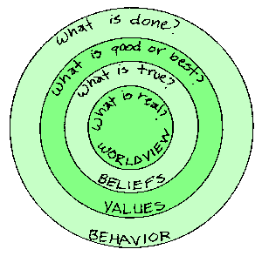

Slide 19
Iceberg: analogy for culture
with credit to Marc Siemens and Gary Weaver

Slide 20
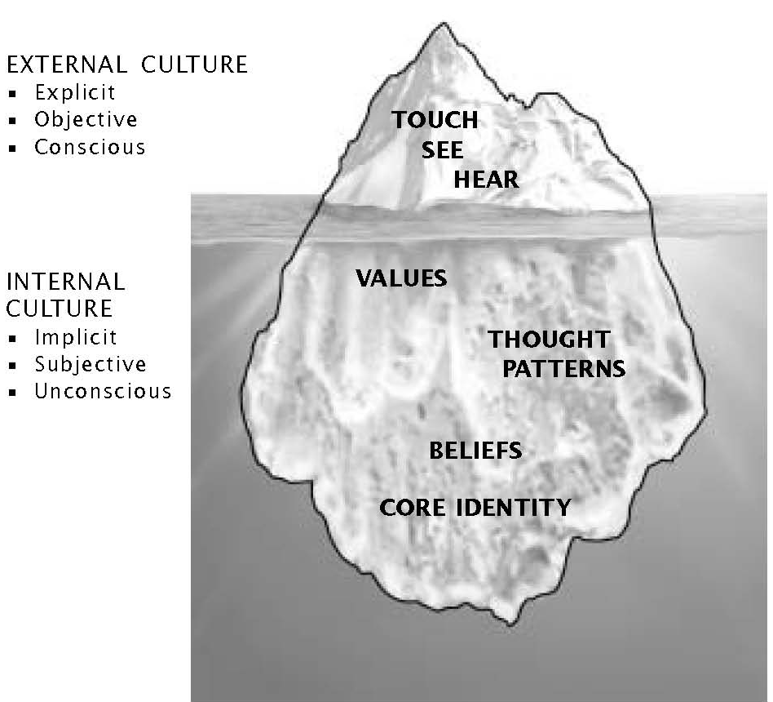

Slide 21
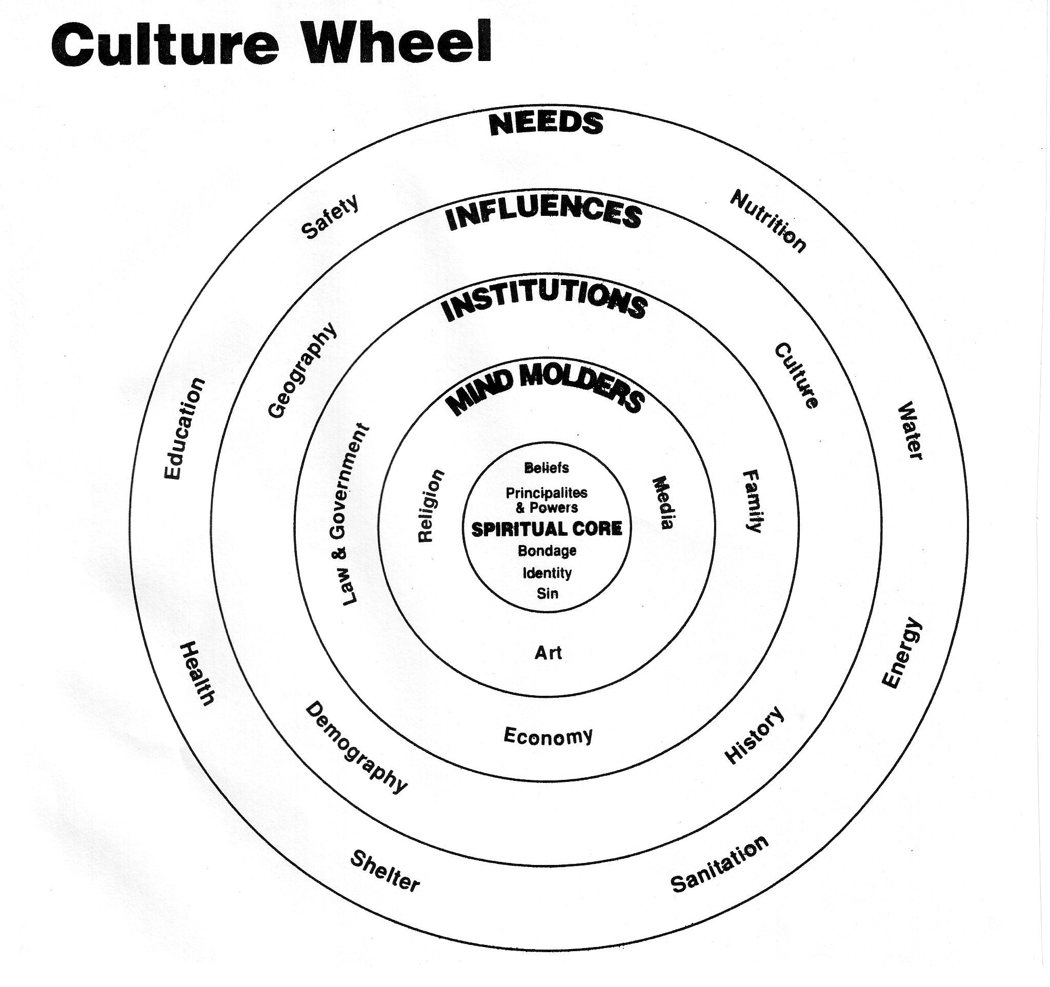
Bob Sjogren, Bill and Amy Stearns

Slide 22
CQ Components
Knowledge
Interpretation
Behavior
Perseverance

Slide 23
Getting people to actively process all four areas
Case studies
Someone from there
Someone who’s been there
Emphasizing relationships
“with” not “for”

Slide 24
Knowledge
An understanding that culture can be seen as the “software” that runs our minds
Some key issues
High context versus low context
Time orientation (event time vs clock time)
Individualism / corporateness
Power distance
Uncertainty avoidance

Slide 25
Interpretation
Turning off cruise control
Holistic observation

Slide 26
Behavior
How do we move to seeing this as an outcome rather than a starting point?

Slide 27
Perseverance
Level of interest, drive and motivation to adapt cross-culturally

Slide 28
This PowerPoint presentation is available along with related materials and other PowerPoint presentations at http://home.snu.edu/~hculbert/ppt.htm

