Slide 1
7 Common Errors of Interpretation
To insert your company logo on this slide
From the Insert Menu
Select “Picture”
Locate your logo file
Click OK
To resize the logo
Click anywhere inside the logo. The boxes that appear outside the logo are known as “resize handles.”
Use these to resize the object.
If you hold down the shift key before using the resize handles, you will maintain the proportions of the object you wish to resize.
How people
find things
in the Bible
that aren’t
really there.
Biblical Perspectives
Southern Nazarene University
Dr. Howard Culbertson

Slide 2
Error #1: Allegorizing TOO much
Allegory: a story or description in which the reader is pointed to a second meaning beneath the surface one.

Slide 3
Allegory: A sustained metaphor
characters and actions represent something else
meanings are hidden behind a story
. . . Or to put it another way . . .

Slide 4
Instead of concentrating on clear and obvious meanings, we look for the real meaning beyond or behind the text
“This stands for . . . . This stands for . . . . ”

Slide 5
Allegories in Scripture
The Prophet Nathan’s story to David (II Kings 12)
Jesus’ parable of the Sower

Slide 6
Stories people like to turn into allegories
Good Samaritan
Jonah

Slide 7
When is it permissible?
When listeners are clearly (and perhaps repeatedly told that the allegory is neither implicit or explicit in Scripture:
Example: “Let’s imagine for a moment. . .”

Slide 8
Error #2: Ignoring the context
Ignoring a passage’s cultural, historical and literary setting

Slide 9
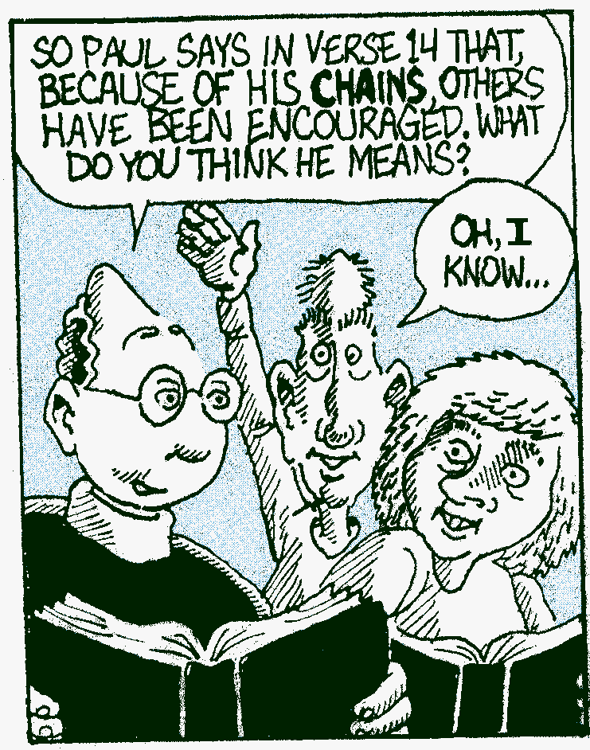

Slide 10
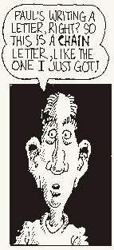

Slide 11
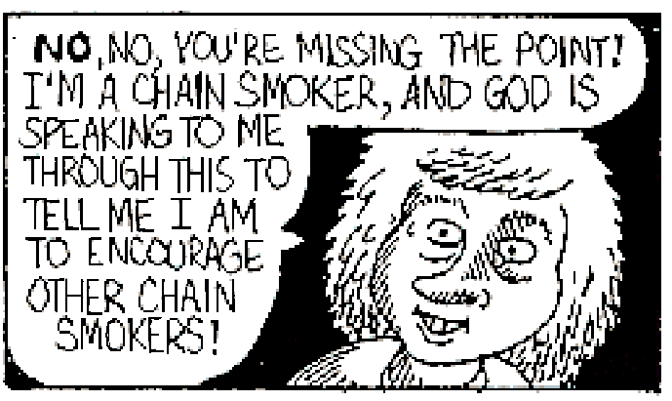

Slide 12
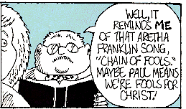

Slide 13
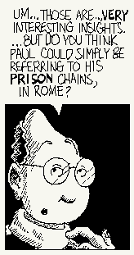

Slide 14
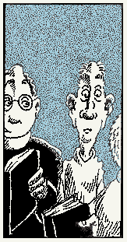

Slide 15
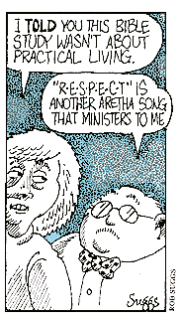

Slide 16
Context is important
Words carry meaning in sentences. For the most part, biblical sentences build their meaning as they relate to preceding and succeeding sentences.
My own Lord’s Supper experience

Slide 17
Context and contradictions
Those who claim the Bible is full of contradictions often find them because they haven’t read the passages in context.

Slide 18
Error #3: Over-selectivity
Choosing specific words and phrases while ignoring others
Danger: may miss the overall sweep of a passage
“Missing the forest for the trees”

Slide 19
Error #4: False Combinations
Takes phrases and verses from here and there and makes a point out of the resulting mixture, a point that would not be valid if the passages were considered separately
For example . . .

Slide 20
Example of False Combination:
Psalm 23 must mean one’s real enemies are in the church rather than outside the church

Slide 21
Ridiculous example of False Combination:
Matthew 27:5 and Luke 10:37
“Judas went away and hanged himself . . . Go and do likewise.”

Slide 22
Error #5: Redefinition
When plain mean of a text leaves us cold or it says something we do not want to hear, we re-word it.
So, give me an example . . .

Slide 23
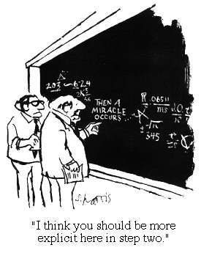
Our scientific mind-set pushes us toward re-definition
Explanations that fit with our current scientific theories and understandings are offered for those Biblical events which seem to be miracles

Slide 24
Sermon on the Mount phrases we want to redefine
Turn the other cheek . . . “Well, you really can’t do that literally.”
Matt. 5:42 -- “Give to the one who asks you, and do not turn away from the one who wants to borrow from you”

Slide 25
Re-definition springs from a different motivation than simply wanting to see the foundational principles behind a passage

Slide 26
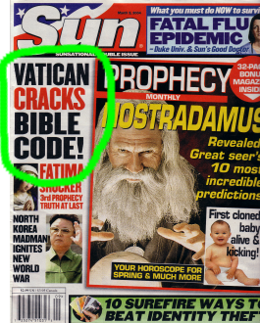
Error #6: Depending on an extracanonical authority
Understanding the Bible takes special knowledge
Only a special external key will unlock Bible “mysteries”
Cults often appeal to an extracanonical authority

Slide 27
Error #7: Personalizing everything
Asking insistently:
What is the moral of this story?
What does this mean for me?
Assuming there’s a very personal meaning in every single Biblical passage
. . . For example

Slide 28
Personalizing a historical event
“Today you are to pass by the region of Moab at Ar” – Deuteronomy 2:18
What does that mean for me?

Slide 29
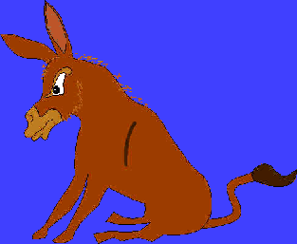
Example:
Balaam’s talking donkey reminds me that I talk too much
Example:
The story of building the temple is God’s way of telling us that we have to construct a new church building.

Slide 30
A final note: Learn to live with some ambiguity
Some questions about the Bible will not be solved this side of eternity.

Slide 31
8 Common Errors of Interpretation (end)
To insert your company logo on this slide
From the Insert Menu
Select “Picture”
Locate your logo file
Click OK
To resize the logo
Click anywhere inside the logo. The boxes that appear outside the logo are known as “resize handles.”
Use these to resize the object.
If you hold down the shift key before using the resize handles, you will maintain the proportions of the object you wish to resize.
How people
find things
in the Bible
that aren’t
really there.
Biblical Perspectives
Southern Nazarene University
Dr. Howard Culbertson

Slide 32
This PowerPoint presentation is available along with related materials and other PowerPoint presentations at http://home.snu.edu/~hculbert/ppt.htm

