Slide 1
What in the world is God doing?
Chuck Gailey
Howard Culbertson

Slide 2
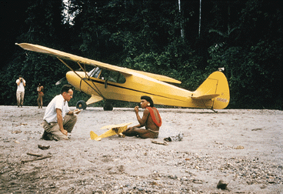

Slide 4
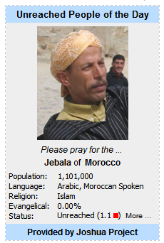
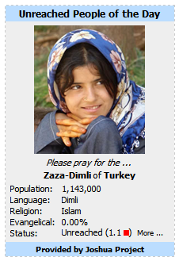
Modern missionary movement progression
Coastlands
Inland areas
Unreached people groups
http://www.joshuaproject.net/

Slide 5
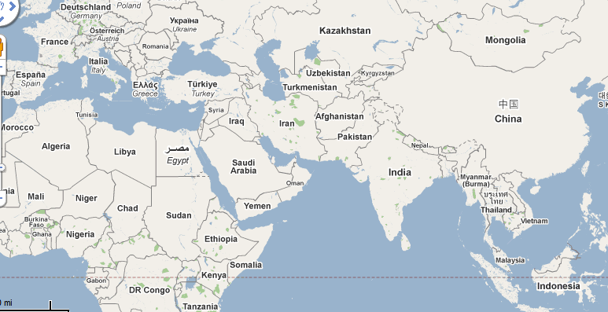
Back to Jerusalem

Slide 6
Back to Jerusalem!
A dream of 100,000 Chinese missionaries
headed westward in the direction of Jerusalem

Slide 7
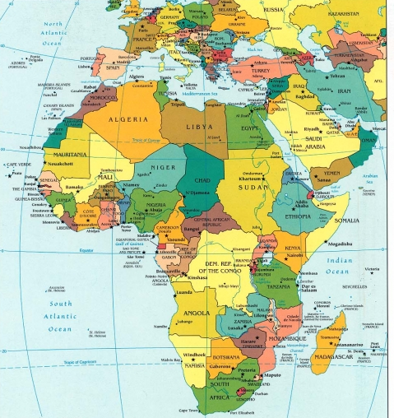
50/15 movement in Nigeria
50,000 missionaries in 15 years

Slide 8
Change of “center of gravity”
No longer always rich to poor
Partnerships
Church planting as focus
From all six continents to all six continents
41 nations now represented in Nazarene missionary force

Slide 9
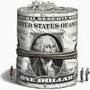
Global economic problems?
“Obedience to the Great Commission has more consistently been poisoned by affluence than by anything else
-- Ralph Winter

Slide 10
This PowerPoint presentation is available along with related materials and other PowerPoint presentations at http://home.snu.edu/~hculbert/ppt.htm

