Slide 1
Christian Community Development
Howard Culbertson
Southern Nazarene University

Slide 3
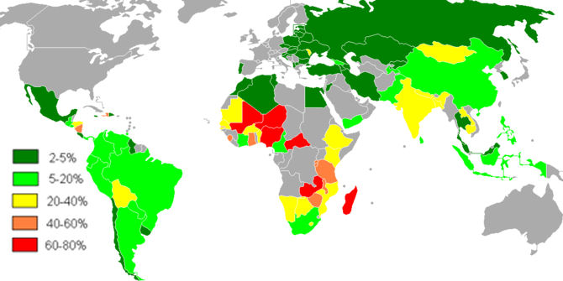
Percentage of population living on $1 or less per day

Slide 4
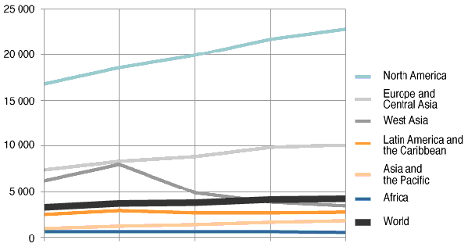
Per capita gross national product

Slide 5
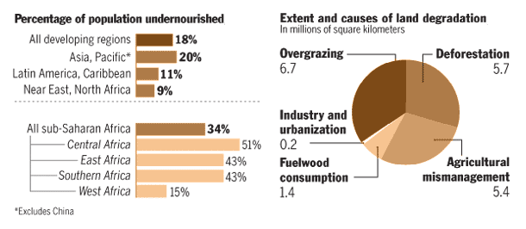

Slide 6
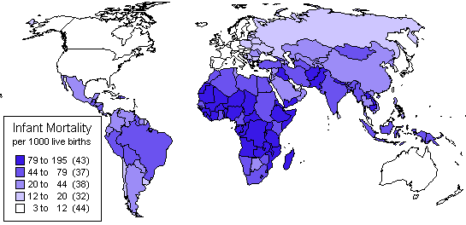

Slide 7
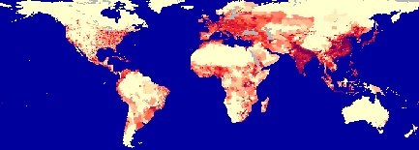
Population density

Slide 8
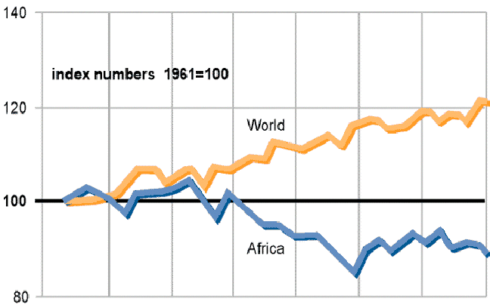
Per capita food production

Slide 9
← 25 years →
← 25 years →

Slide 10
Percent of underweight children under 5

Slide 11
Six plagues of our mis-developed world
Poverty
Illiteracy:
  The curse of not knowing
Dispossession:
  The hungry travelers
The calamities of nature
Urbanization:
  The fatal lure of the city
“The System”:
  Hunger amidst plenty

Slide 12
How do we react to such huge, complex problems?
“If they would just . . .”
“It’s not my business”
“There’s nothing I can do about it”
“I want to think about it in the light of the gospel”

Slide 13
Should we be involved?
Shouldn’t we be pouring all our resources into saving souls for eternity?
Is there any mandate beyond that of announcing the Good News?

Slide 14
Biblical basis
Old Testament
  Examples?
New Testament
  Examples?
  http://home.snu.edu/~hculbert/poor.htm

Slide 15
“Are you the Messiah?”
Tell John what you see
  Blind receive sight, lame walk, lepers are cleansed, dead are raised and Gospel is being preached to the poor

Slide 16
How can we be the “light” of a mis-developed world?
Motivation
  “Let my heart be broken with the things that break the heart of God” -- Bob Pierce, World Vision
“How”
  Inappropriate
  Appropriate

Slide 17
Christian Community Development
What is it?
What it is not.

Slide 18
What community development is not . . .
1. Redistribution of wealth
  “Eat your broccoli!”
2. A multitude of “projects”
  Enthusiasm and goodwill are not enough

Slide 19
What community development is not . . .
3. Simply an increase in the gross national product
  Haiti’s economic problem: “Too much capital” to absorb

Slide 20
Community development aims
1. Meeting minimum standards
  Food / nutrition
  Health
    Preventable diseases
      Every 8 seconds, child dies from water-related disease
    Pollution
  Education

Slide 21
Community development aims
2. Empowerment
3. Giving dignity and respect
4. Promoting peace and harmony (the shalom of God)

Slide 22
The most successful development efforts are directed at single communities
Successful ones I’ve been involved in:
  Vegetable gardening
  Well drilling
  Pigs
  Roads
  Tree planting

Slide 23
7 pitfalls and detours
1. Demagoguery based on myths
  Myth: Food production is lagging behind population growth
    Some say: “There simply isn’t enough food.”

Slide 24
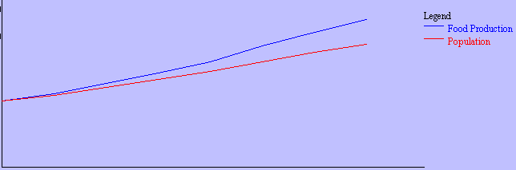
Myth: Global overpopulation is the main cause of famine
Truth: Famine’s causes are complex

Slide 25
Myth: The amount of “X” is finite and fixed.
  We’re in a zero-sum game. What one person gets/uses of “x” means there is less for every other person
  Result: brief guilt trips for developed nations
    Example: Boycotts of Haitian industries

Slide 26
Myth: We have to solve people’s material needs before spiritual needs can be addressed

Slide 27
Pitfalls and detours
2. Ethnocentric attitudes of aid-givers themselves
  We can solve your problem. We have the answers.
      Railroad car of corn
  Authoritarianism
    Whoever pays the bills calls the shots
      Village relocation after flood
      Rainwater catchment systems

Slide 28
Pitfalls and detours
3. Expectations of easy answers and immediate results
  “Crash” programs tend to crash
  Relief and development are different strategies

Slide 29
Pitfalls and detours
4. Temptation to bulldoze through local opposition
5. Inflexible administrative systems

Slide 30
Pitfalls and detours
6. “Rice Christians”
    How serious a problem?
7. “Compassion fatigue”

Slide 31
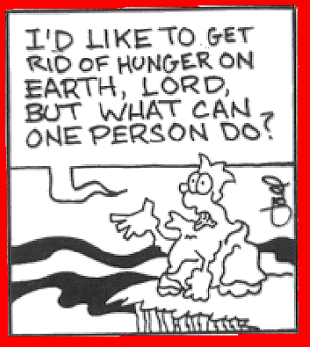
Pontius’ Puddle – The Preacher’s Magazine

Slide 32
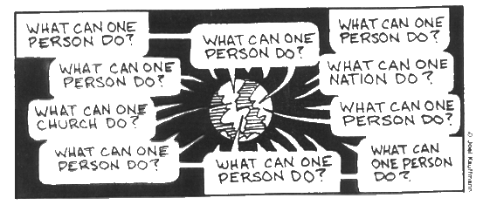

Slide 33
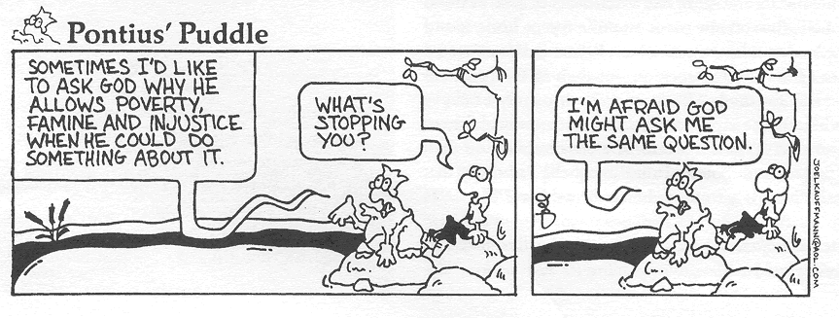

Slide 34
This PowerPoint presentation is available along with related materials and other PowerPoint presentations at http://home.snu.edu/~hculbert/ppt.htm

