Slide 1
Defining “culture” and cultural anthropology
Howard Culbertson
Southern Nazarene University

Slide 2
“A few years ago I took a cultural anthropology class at a community college. This class studied people in great detail but never really mentioned what culture was. We assumed we were studying culture, but the [word culture] was never truly defined.”
    A student in Global Evangelism class

Slide 3
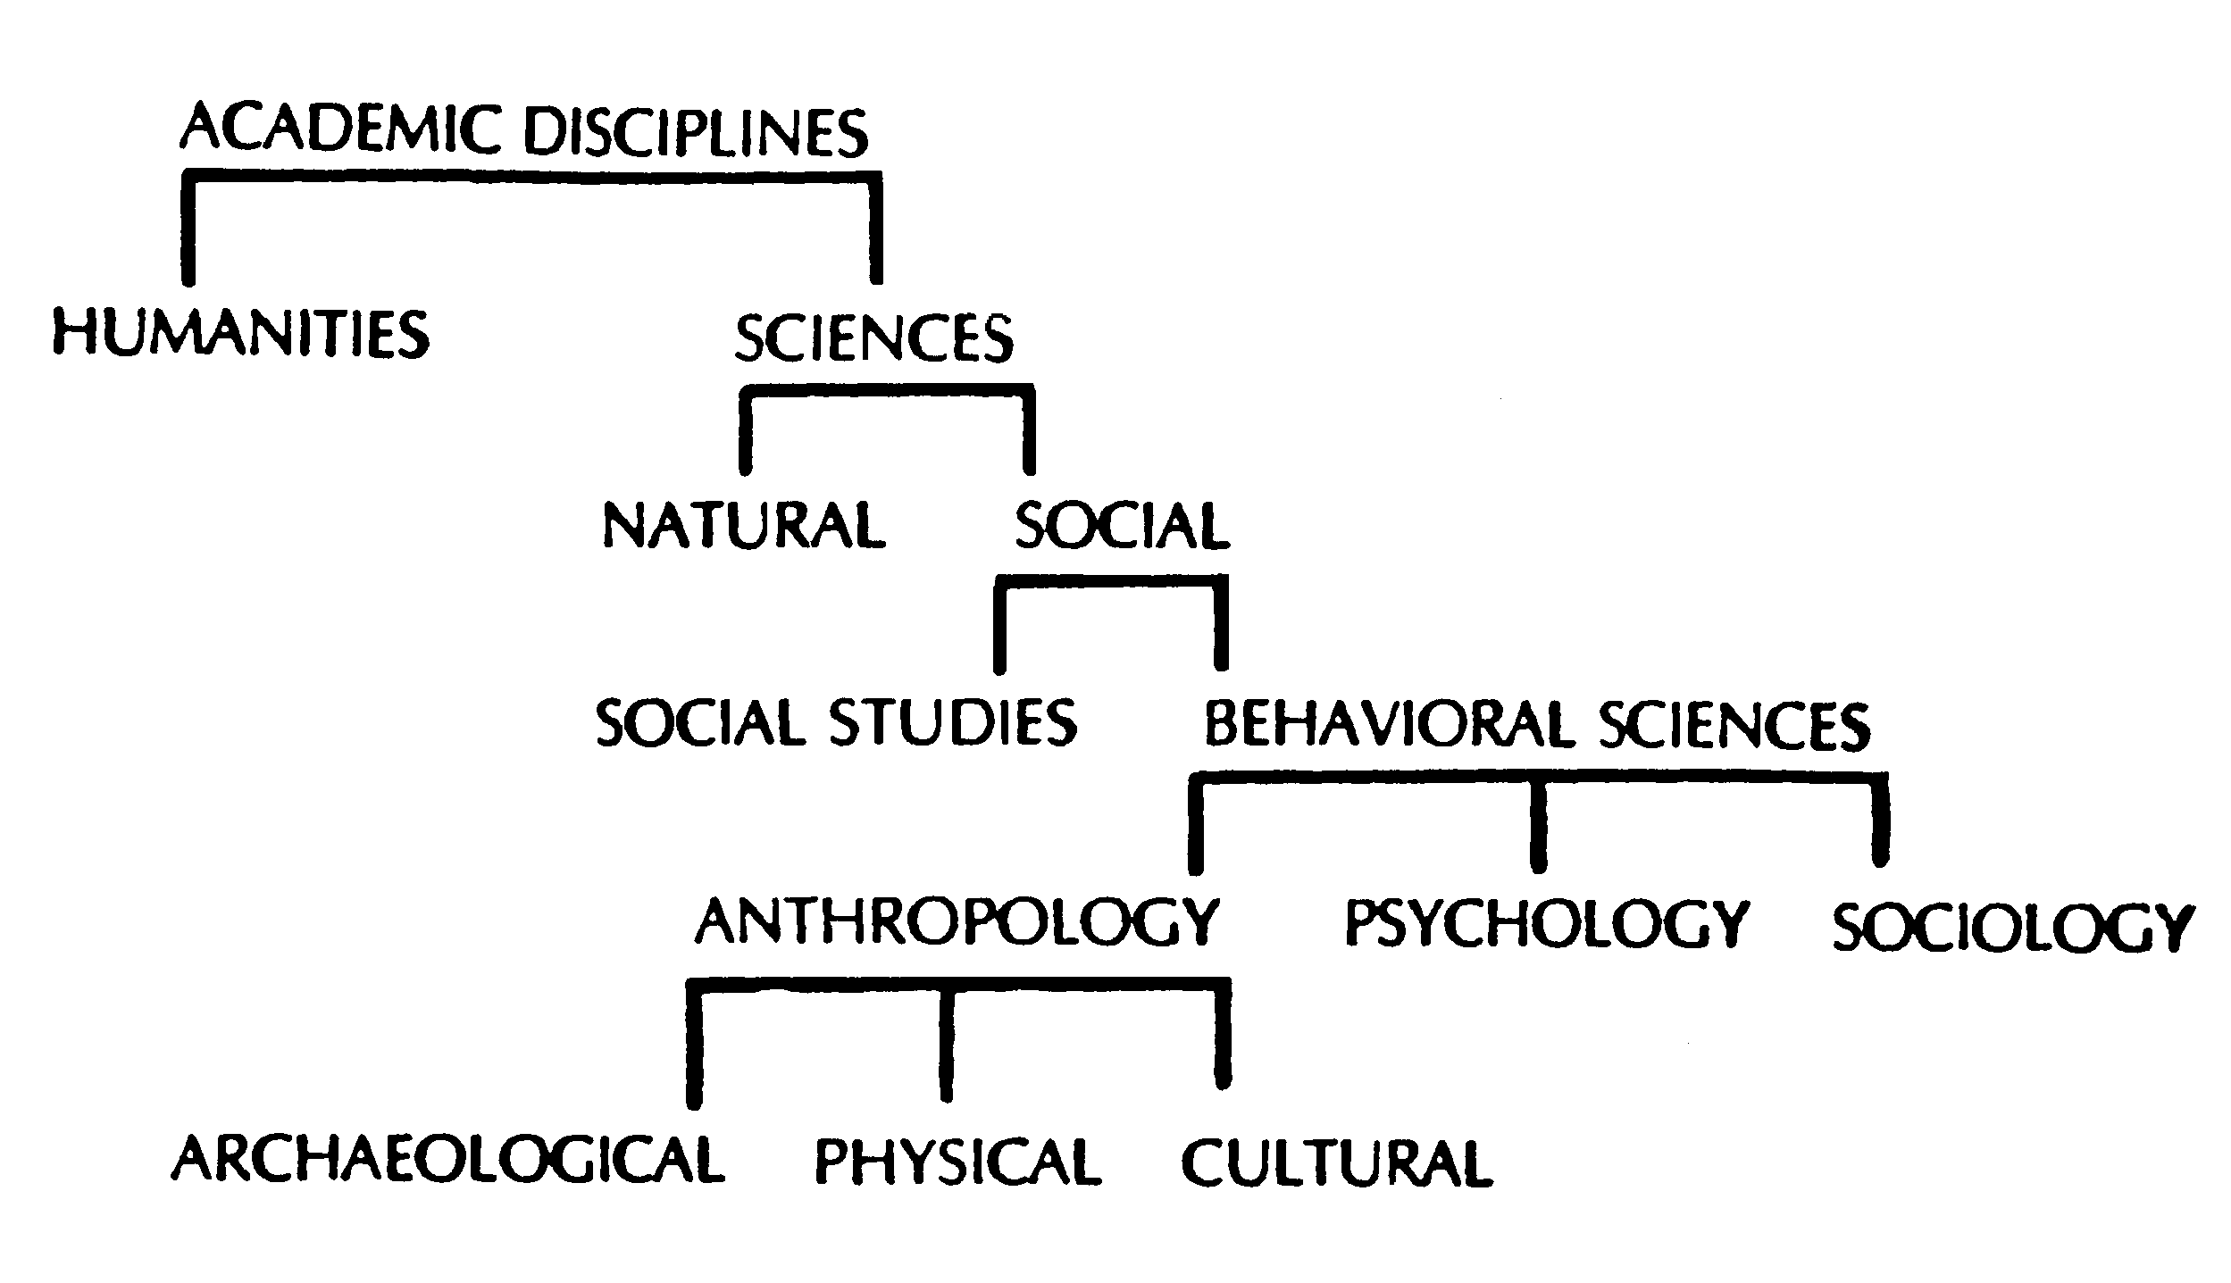
Cultural Anthropology -- an academic discipline

Slide 4
Cultural Anthropology -- an academic discipline

Slide 5
Cultural Anthropology -- an academic discipline

Slide 6
Cultural Anthropology -- an academic discipline

Slide 7
Cultural Anthropology -- an academic discipline

Slide 8
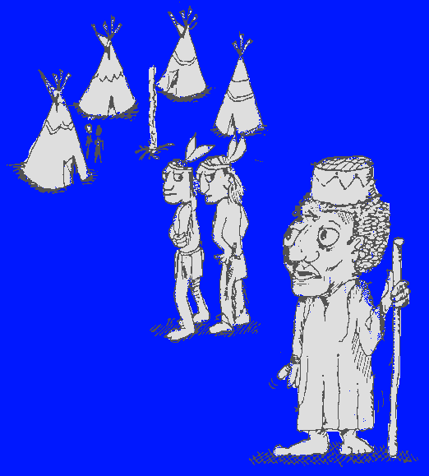
Culture is what makes you a stranger when you are away from home

Slide 9
Defining culture
Philip Bock – What makes you a stranger when you’re away from home
Ruth Benedict – learned patterns
Charles Kraft – Complex, integrated coping mechanism
Bob Sjogren -- What makes us “us” and them “them”

Slide 10
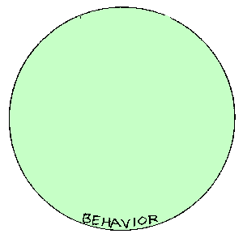
Viewing culture as successive levels
Diagram by Lloyd Kwast

Slide 11
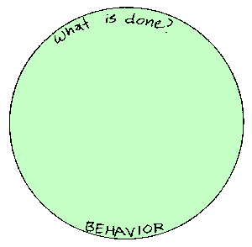

Slide 12
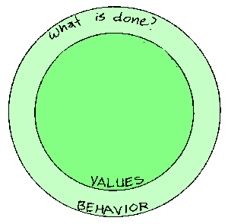

Slide 13
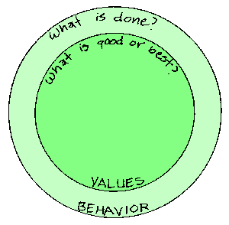

Slide 14
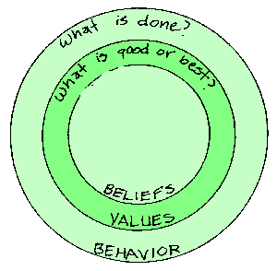

Slide 15
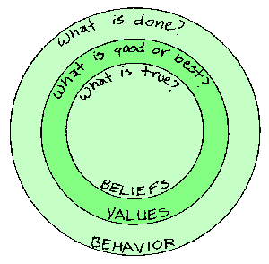

Slide 16
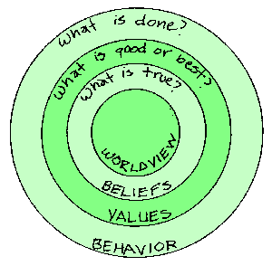

Slide 17
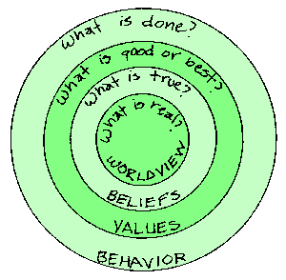

Slide 18

An iceberg as an analogy of culture

Slide 19
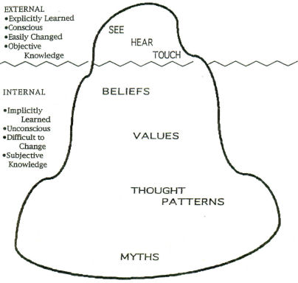
From Gary Weaver in Culture, Communication and Conflict: Readings in Intercultural Relations

Slide 20
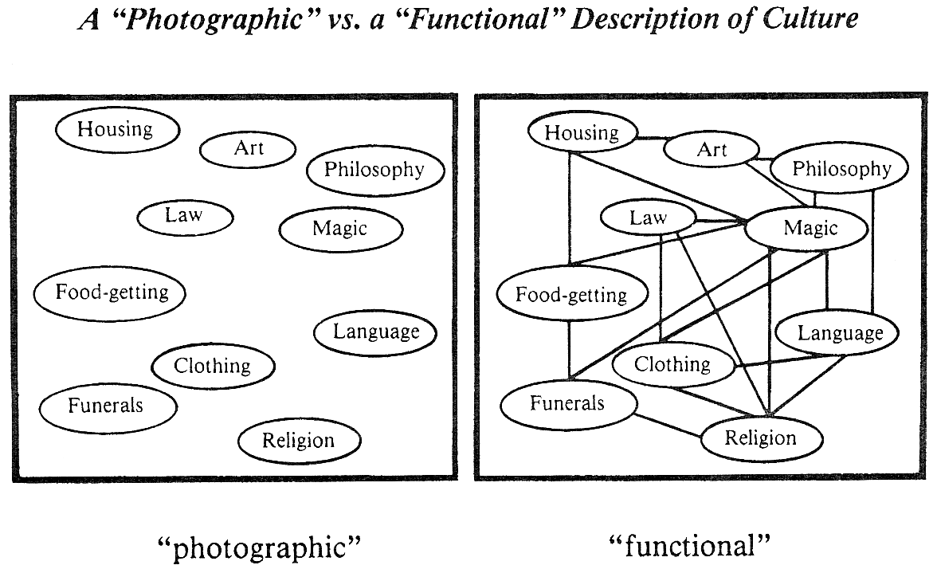

Slide 21
Culture is a complex, integrated coping mechanism.
Culture consists of
1. Learned concepts and behavior
2. Underlying perspectives (worldview)
3. Resulting products
    nonmaterial (customs and rituals)
    material (artifacts)
      Chuck Kraft’s definition

Slide 22
Scattered thoughts about Cultural Anthropology
It’s holistic (as opposed to atomistic or narrow)
It’s comparative
  Etic (from outsider’s vantage point)
  Emic (from an insider’s vantage point
Perspectives run the gamut from relativism to ethnocentrism
You will get your hands dirty (fieldwork)

Slide 23
What makes up a culture?
What are those learned patterns and behaviors?

Slide 24
Cultural Universals
George Murdock’s 70 cultural universals

Slide 25
age-grading athletic sports bodily adornment calendar cleanliness training community organization cooking co-operative labor cosmology courtship dancing decorative art divination division of labor dream interpretation education eschatology | ethics ethno-botany etiquette faith healing family feasting fire-making folklore food taboos funeral rites games gestures gift-giving government greetings hair styles hospitality | housing hygiene incest taboos inheritance rules joking kin groups kinship nomenclature language law luck / superstitions magic marriage mealtimes medicine obstetrics penal sanctions personal names | population policy postnatal care pregnancy usages property rights propitiation of supernatural beings puberty customs religious ritual residence rules sexual restrictions soul concepts status differentiation surgery tool-making trade visiting weather control weaving

Slide 26
9 cultural universals

Slide 27



1. Place and time

Slide 28
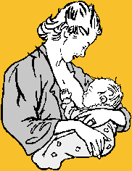
2. Family life

Slide 29

3. Economics

Slide 30


4. Food, clothing, shelter and transportation
See note

Slide 31
Note: “Drives” vs. culture
Hunger is a basic human psycho-biological drive.
How that hunger is satisfied involves all kinds of cultural things (what is eaten, how it is prepared, how it is eaten . . .).

Slide 32

5. Communication

Slide 33
6. Government

Slide 34


7. Arts and recreation

Slide 35
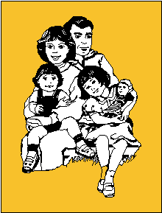
8. Education

Slide 36

9. Quest for the supernatural

Slide 37
Sociocultural change

Slide 38
Is it worth my time?
Question: Why study cultural anthropology?
Answer: To enrich a college education by giving new insights about ourselves and our own cultural context as well as stretching our imaginations.

Slide 39
This PowerPoint presentation is available along with related materials and other PowerPoint presentations at http://home.snu.edu/~hculbert/ppt.htm

