Slide 1
“Please don’t send me to Africa”
Lyrics and music by Scott Wesley Brown and Phill McHugh
Copyright 1988, BMG Songs / Pamela Kay Music

Slide 2
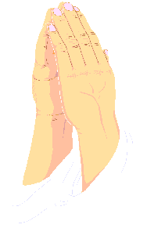
O Lord, I am your willing servant
You know that I have been for years

Slide 3
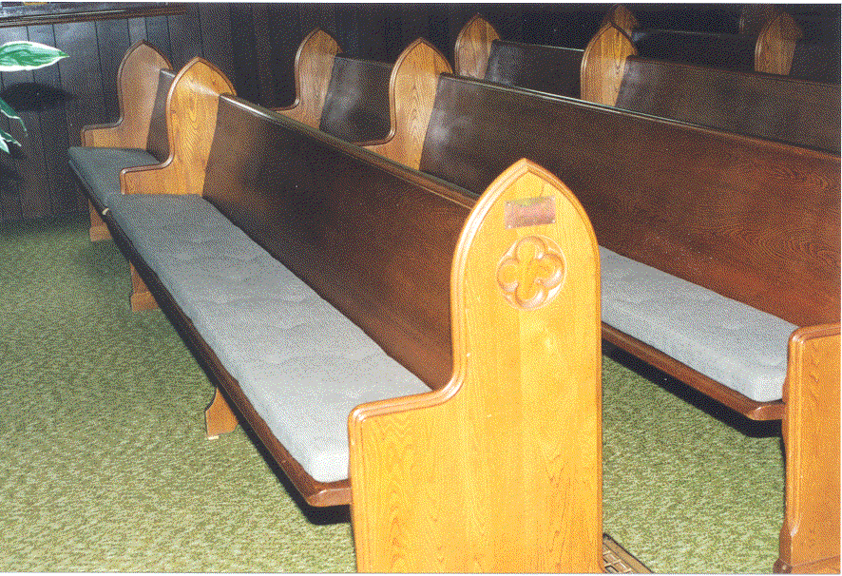
I'm here in this pew every Sunday and Wednesday.
I've stained it with many a tear .

Slide 4
I've given you years of my service.
I've always given my best.

Slide 5
And I've never asked you for anything much;
So, Lord, I deserve this request:

Slide 6
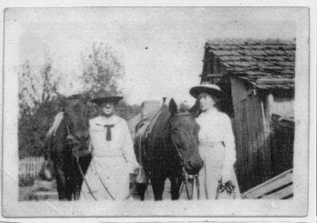
Please don't send me to Africa
I don't think I've got what it takes.

Slide 7
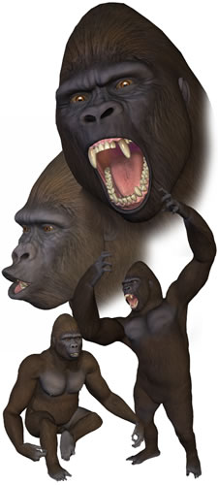
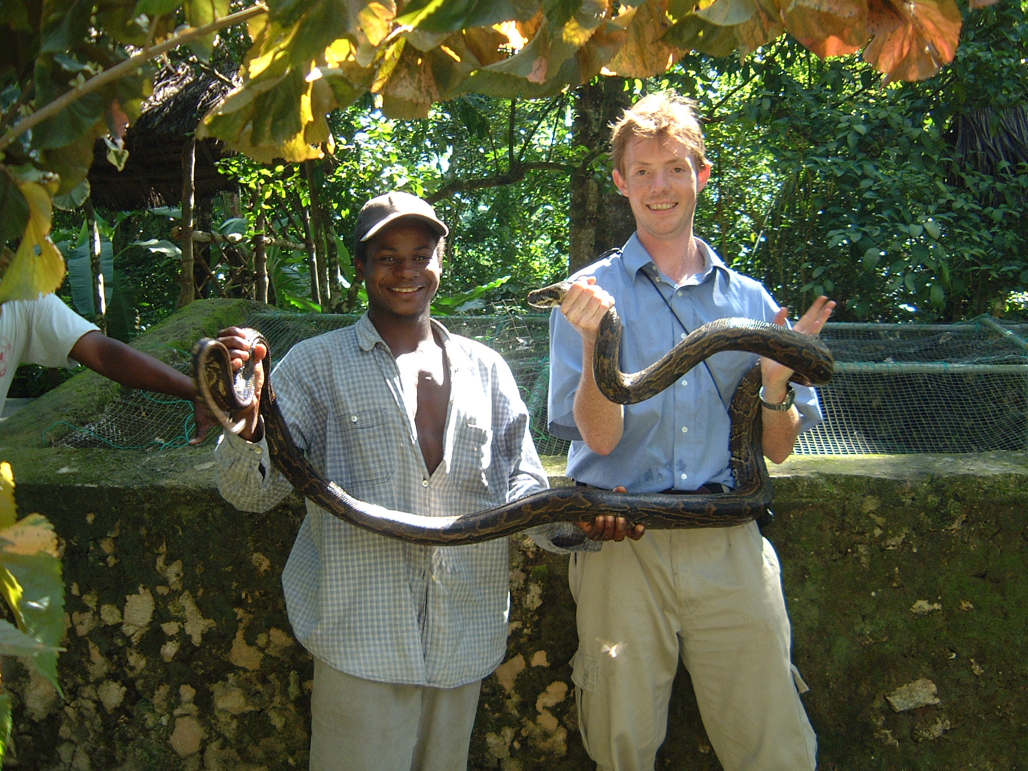
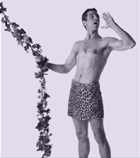
I'm just a man; I'm not a Tarzan
I don't like lions, gorillas or snakes

Slide 8
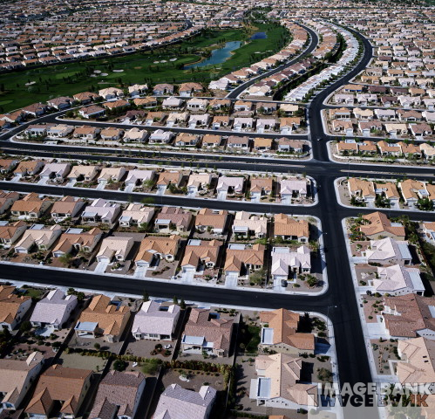
I'll serve you here in Suburbia
In my comfortable middle class life.

Slide 9
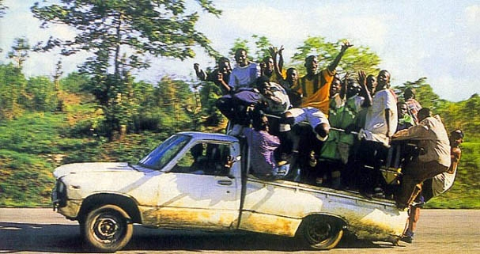
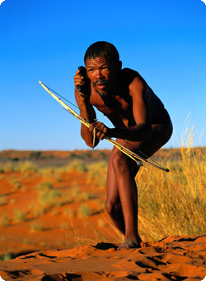
But please don't send me out into the bush
Where the natives are restless at night

Slide 10
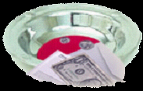
I'll see that the money is gathered.
I'll see that the money is sent.

Slide 11
I'll wash and stack the communion cups.
I'll tithe eleven percent.

Slide 12
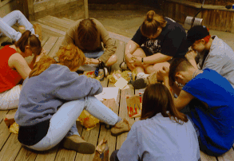
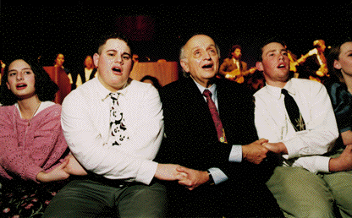
I'll volunteer for the nursery;
I'll go on the youth group retreat.

Slide 13
I'll usher; I'll deacon; I'll go door to door.
Just let me keep warming this seat.

Slide 14
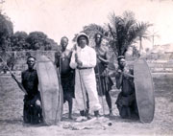
Please don't send me to Africa
I don't think I've got what it takes.

Slide 15
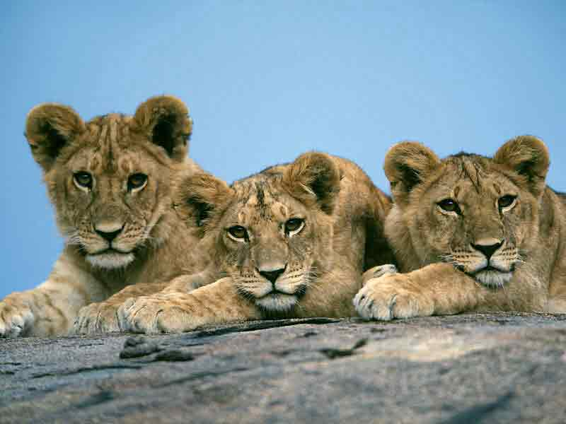
I'm just a man; I'm not a Tarzan
I don't like lions, gorillas or snakes

Slide 16
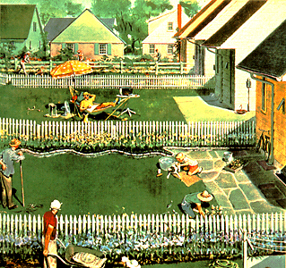
I'll serve you here in Suburbia
In my comfortable middle class life

Slide 17
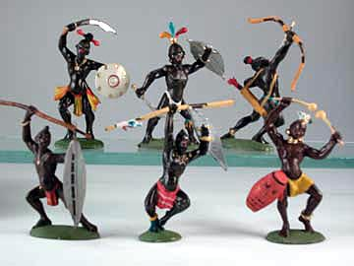
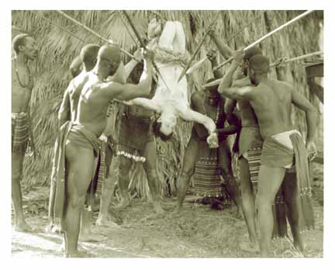
But please don't send me out into the bush
Where the natives are restless at night.

Slide 18
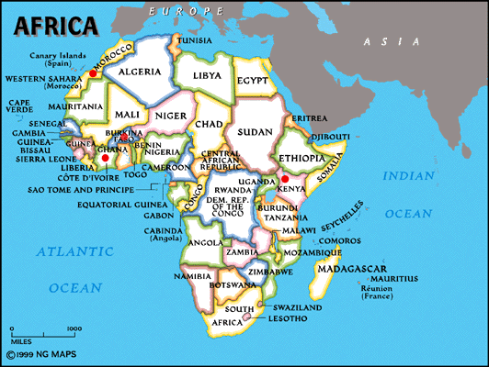
Please don't send me to Africa
I don't think I've got what it takes.

Slide 19
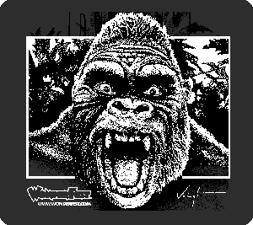
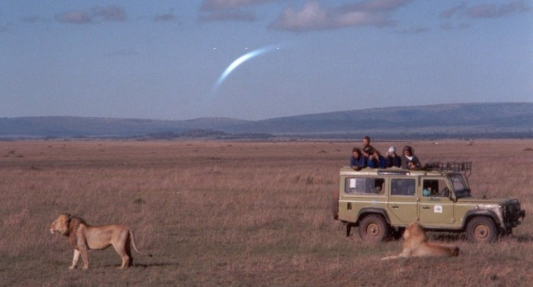
I'm just a man; I'm not a Tarzan
I don't like lions, gorillas or snakes

Slide 20
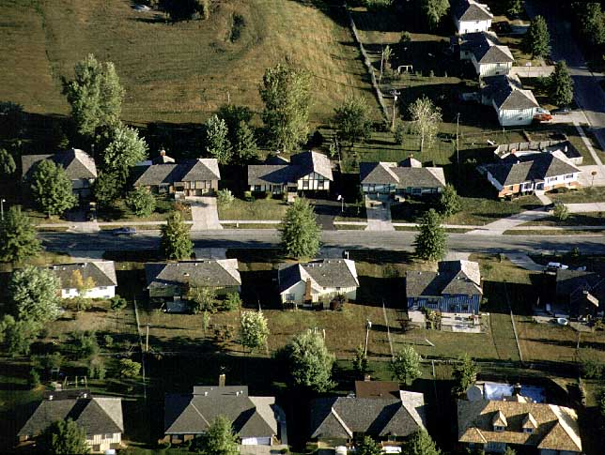
I'll serve you here in Suburbia
In my comfortable middle class life

Slide 21
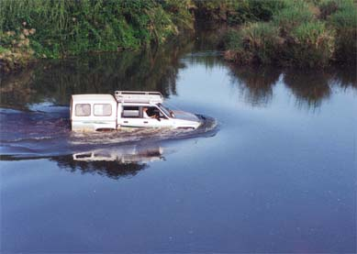
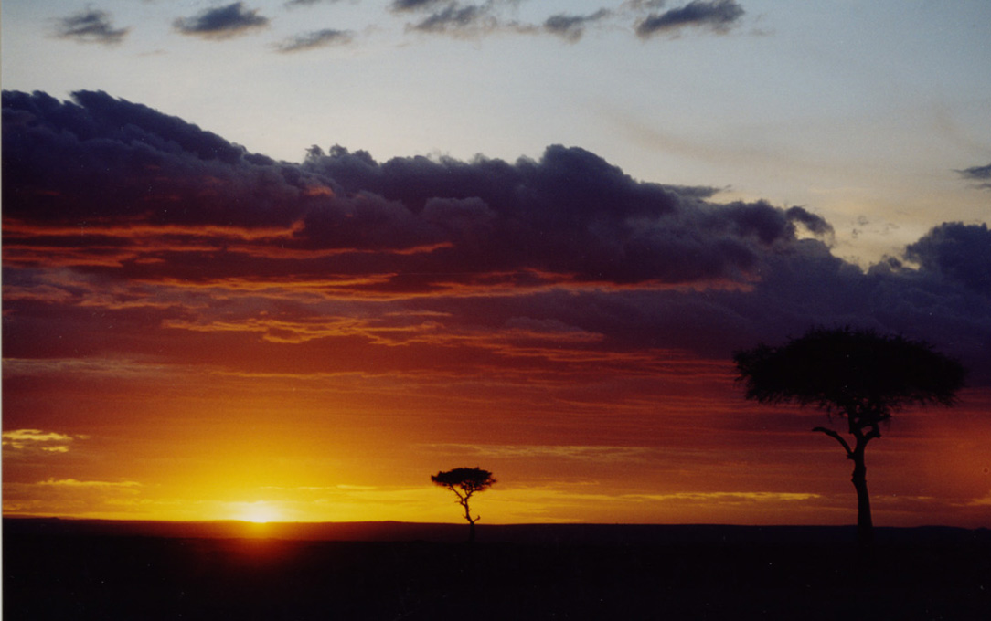
But please don't send me to the ends of the earth
Where the natives are restless at night.

Slide 23
Okay, I’ll go.

Slide 24
This PowerPoint presentation is available along with related materials and other PowerPoint presentations at http://home.snu.edu/~hculbert/ppt.htm

