Slide 1
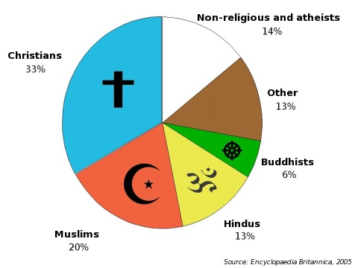
http://chato.cl/blog/files/religions_world.jpg

Slide 2
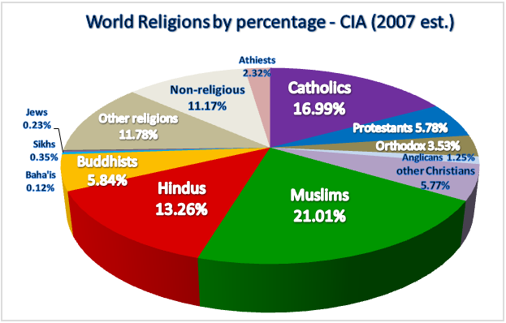
http://upload.wikimedia.org/wikipedia/commons/archive/7/72/20080701121225!World_religions_pie_chart.png

Slide 3
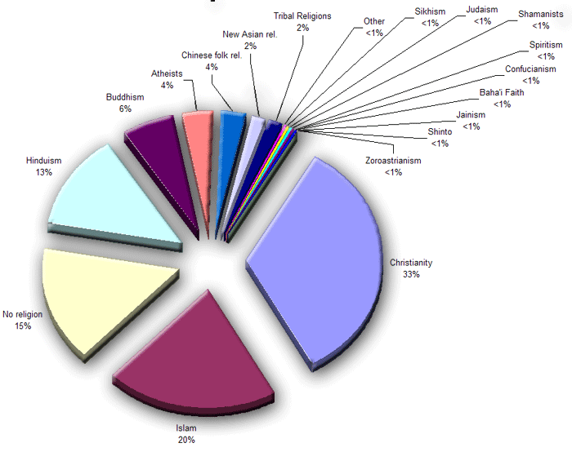
http://www.ecentrify.com/discuss/religion/images/pie_chart.gif

Slide 4
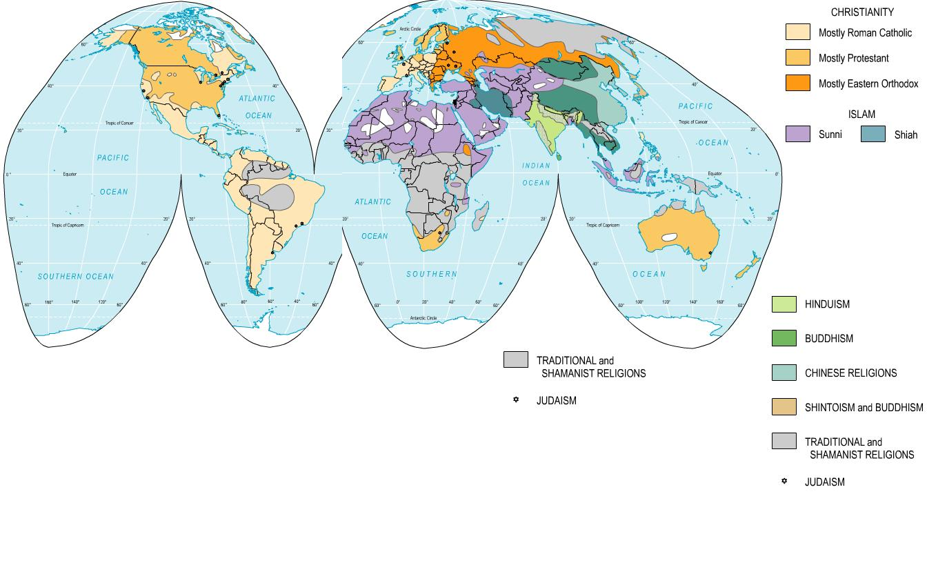

Slide 5
This PowerPoint presentation is available along with related materials and other PowerPoint presentations at http://home.snu.edu/~hculbert/ppt.htm

